Slide 1
UTERINE EVACUATION IN CRISIS SETTINGS USING MANUAL VACUUM ASPIRATION
Clinical Outreach Refresher Training Module for Health Care Providers Implementing the Minimum Initial Service Package (MISP) for Sexual and Reproductive Health

Slide 2
UNIT 1: COURSE OVERVIEW

Slide 3
Unit 1 objectives
Participants will become familiar with one another, the course overview and the course objectives

Slide 4
COURSE OBJECTIVES
At the end of this workshop, participants will be able to:
Explain why uterine evacuation is an essential part of reproductive health services in crisis settings
Counsel women seeking abortion in crisis settings
Provide uterine evacuation for women in crisis settings using manual vacuum aspiration (MVA)
Recognize and manage women who develop complications from uterine evacuation with MVA
Integrate MVA into their present reproductive health services and organize and monitor the services
Notes:
Note to trainer: These are the overall course objectives. More detailed learning objectives for each unit will be reviewed at the start of each unit. Ask participants to take turns reading the objectives out loud.

Slide 5
KNOWLEDGE PRE-TEST
Notes:
Ask participants to turn to the Knowledge Pre-test in their manual and tell them they have about 15 minutes to complete it.
Prepare small pieces of paper with numbers and ask each participant to pick a number. This number will be used for tests and other assessments throughout the course and should be kept by all participants for reference. The facilitator notes the names and numbers to keep on record. Participants write their number on the paper and collect all tests at the end of the allotted time. This allows for results to be shared anonymously.

Slide 6
UNIT 2: UTERINE EVACUATION IN CRISIS SETTINGS

Slide 7
Unit 2 objectives
By the end of this unit, participants will be able to:
Explain why uterine evacuation is an essential part of reproductive health services in crisis settings
Articulate their own comfort levels discussing, advocating and providing uterine evacuation services
Explain what the current abortion law is in their setting and how it relates to what and how services are provided

Slide 8
UTERINE EVACUATION IS AN IMPORTANT ELEMENT OF REPRODUCTIVE HEALTH IN CRISIS SETTINGS
Notes:
Write the following numbers on a blank sheet of flip chart paper:
5
25,100,000
8%
99%
55,700,000
193,000
Lead a discussion. Ask participants the following questions:
How many pregnancies across the world end in abortion (induced, spontaneous, safe, unsafe, etc.)?
Circle 55,700,000 on the flip chart. The World Health Organization (WHO) estimates that 55 million abortions have occurred every year from 2010 to 2014.
How many abortions are performed each year that are considered unsafe by the World Health Organization definition?
Circle 25,100,000 on the flip chart. Worldwide, there are an estimated 25.1 million unsafe abortions performed every year; 45% of all abortions are unsafe. This means abortions performed by people who lack the necessary skills or in an environment lacking minimum medical standards for the procedure, or both.
Draw a circle. What percent of maternal deaths are caused by unsafe abortion?
Circle 8 percent. Draw (but do not fill in) 8 percent in the circle on the flip chart. Globally, unsafe abortion accounts for 8 percent of maternal deaths; it is the 5th leading cause of maternal mortality.
How much (what percentage) within that 8 percent do you think takes place in low- and middle-income countries?
Fill in the wedge of 8 percent, leaving just one tiny sliver unfilled. Draw an arrow from the 8 percent out of the circle to the 99 percent written on the flip chart. Say 99 percent of maternal deaths due to abortion occur in low- and middle-income countries.

Slide 9
Making pregnancy safer
Provision or referral for safe abortion services
Timely and appropriate management of unsafe and spontaneous abortion for all women
Notes:
Explain: Making pregnancy safer includes the provision of, or referral for, safe abortion services to the full extent allowed by the law. It also includes timely and appropriate management of unsafe and spontaneous abortion for all women.
Ask: Why might women and girls in crisis settings be at an increased risk of unintended pregnancy and unsafe abortion?
Write responses on the flip chart. Ensure that they include:
Women may have lost or run out of their contraceptive method during displacement.
Families may want to delay childbearing until their security and livelihoods are assured, and do not have access to contraceptives due to the disruption in health services.
Rape and other forms of sexual violence are often documented in conflict settings.
Explain: In 2003, the World Health Organization issued technical and policy guidance to strengthen the capacity of health systems to provide safe abortion care and postabortion care (PAC). This guidance was updated and reissued in 2012. In 2014 the World Health Organization issued guidance for the clinical provision of abortion, and in 2018 they issued new guidance on the medical management of abortion. In 2022, WHO issued new Abortion Care Guidelines, which updated and replaced the guidance in all the above.
On the flip chart write: “PAC” and the number “5.”
Ask participants to raise their hand if they are familiar with the term PAC. Ask a volunteer to explain it.
Explain: PAC is a global strategy to reduce death and suffering from the complications of unsafe and spontaneous abortion.
Ask participants if they know how the number five (5) relates to PAC. Tell them PAC has five components.

Slide 10
Elements of PAC
Treatment of incomplete and unsafe abortion and complications that are potentially life-threatening.
Counseling to identify and respond to women’s emotional needs, physical health needs, and other concerns.
Contraceptive and family planning services to help women prevent an unwanted pregnancy or practice birth spacing.
Notes:
Adapted from the Postabortion Care Consortium Community Task Force. Essential Elements of Postabortion Care: An Expanded and Updated Model, PAC in Action #2 Special Supplement, September 2002
Corbett, M., Turner, K. Essential Elements of Postabortion Care: Origins, Evolution and Future Directions. International Family Planning Perspectives, 2003, 29(3):106-111.

Slide 11
Elements of PAC (cont.)
Reproductive and other health services, preferably provided on-site or via referrals to other accessible facilities in providers’ networks.
Community and service provider partnerships for prevention of unwanted pregnancies and unsafe abortion, mobilization of resources to help women receive appropriate and timely care for complications from abortion, and ensuring that health services reflect and meet community expectations and needs.
Notes:
Adapted from the Postabortion Care Consortium Community Task Force. Essential Elements of Postabortion Care: An Expanded and Updated Model, PAC in Action #2 Special Supplement, September 2002
Additional Resource: Corbett, M., Turner, K. Essential Elements of Postabortion Care: Origins, Evolution and Future Directions. International Family Planning Perspectives, 2003, 29(3):106-111.
Ask participants if they are familiar with the term CAC. Ask a volunteer to provide an explanation.
Circle the number one (1) on the flip chart sheet.
Explain that CAC stands for comprehensive abortion care. It includes all the elements of PAC with one important addition: safe induced abortion for all legal indications.
On a new sheet of flip chart paper, write the number one (1). Now write 22,000,000. Tell participants that adding this one element to reproductive health services would improve the health and possibly save the lives of 22 million women each year.
Now, write:
PAC + CAC = ↓ maternal death.
Together, PAC and CAC contribute to reductions in maternal mortality.

Slide 12
VALUES CLARIFICATION
Notes:
See activity in the Facilitator’s Guide.

Slide 13
REVIEW OF ABORTION LAWS

Slide 14
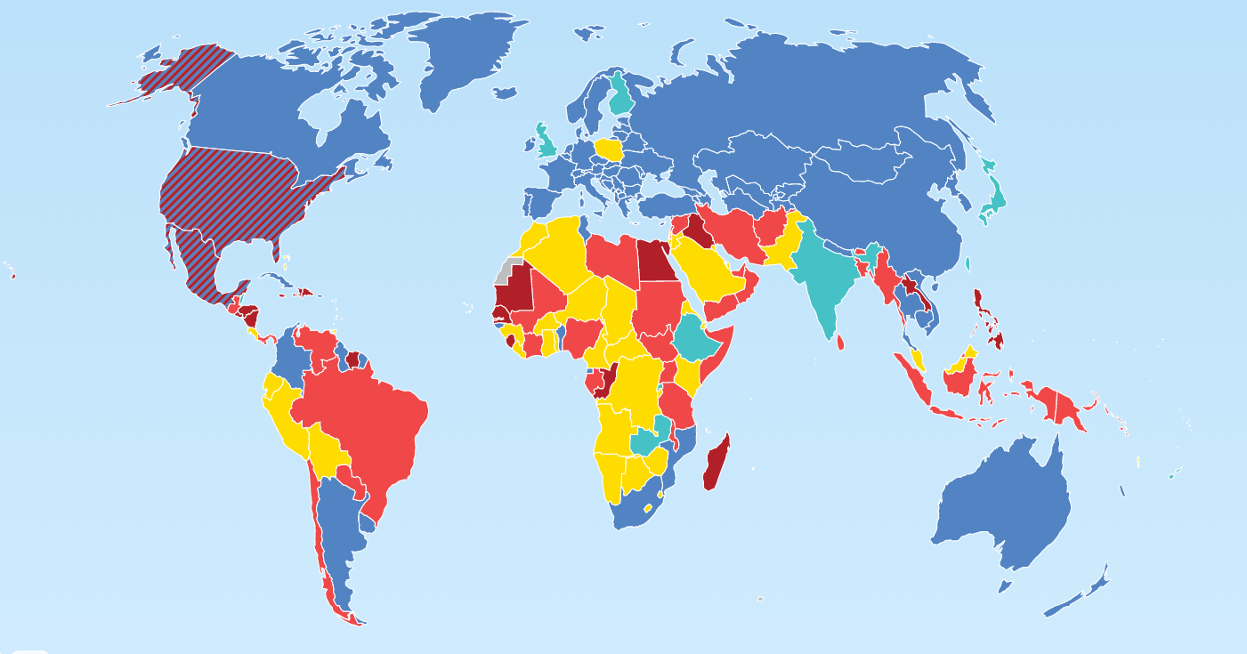
Abortion is legally permitted
Center for Reproductive Rights, 2023
Notes:
Explain:
In most countries, abortion is legally permitted to save the woman’s life, preserve her health, and/or for other indications. Most women live in countries where induced abortion is permitted, with or without restrictions.
On this map:
Dark red = prohibited altogether
Red = to save the woman’s life
Yellow = to preserve health
Light blue = socioeconomic grounds
Dark blue = on request within gestational limits
Stripes = legal status varies at the subnational level
This is an image from the Center for Reproductive Rights World Abortion Laws 2023.
Visit www.worldabortionlaws.com for the most current version of this map.

Slide 15
Legal grounds for Abortion
United Nations, 2013
Notes:
Explain:
According to data compiled by the United Nations (Department of Economic and Social Affairs, Population Division) regarding abortion policies in 196 countries:
97 percent permit abortion to safe the woman’s life
68 percent permit to preserve physical health and 65 percent permit to preserve mental health
51 percent permit safe abortion for rape or incest
50 percent for fetal impairment
35 percent for economic or social reasons
30 percent upon request
While this slide only shows data through 2011, the trend toward more liberal abortion laws has continued over the past decade.
Source: United Nations Department of Economic and Social Affairs, Population Division. (2013). World Abortion Policies 2013 Wall Chart. www.unpopulation.org.

Slide 16
Abortion laws and policies in (Country/Setting)
Facilitator – add content here about the abortion laws and policies for the country/setting in which you are training
Notes:
Present the current law on abortion for the crisis-affected setting where you are working.
Note to trainer: If you prepared a handout or a short PowerPoint presentation about the law, present it here.

Slide 17
CASE STUDIES

Slide 18
UNIT 3: UTERINE EVACUATION METHODS

Slide 19
Unit 3 objectives
By the end of this unit, participants should be able to:
Describe the various uterine evacuation options and explain why they are especially useful in crisis settings
Describe the safety, efficacy, and possible complications of MVA
Explain how medical abortion and misoprostol for incomplete abortion may be useful options for some women in crisis settings with MVA backup
Provide UE procedure options counseling for women seeking uterine evacuation
Obtain informed consent prior to uterine evacuation

Slide 20
METHOD OPTIONS FOR UTERINE EVACUATION

Slide 21
Uterine evacuation methods
Uterine evacuation removes contents of the uterus
Recommended methods for providing uterine evacuation before 13 weeks gestation:
Vacuum aspiration
Medical methods
Expectant management for incomplete abortion

Slide 22
Obsolete method: Sharp curettage (SC)
WHO: “Dilatation and curettage (D&C) is an obsolete method of surgical abortion and should be replaced by vacuum aspiration and/or medical methods.”
International Federation of Gynecology and Obstetrics (FIGO) supports vacuum aspiration and medical methods over SC.
SC has increased blood loss, pain, procedure time, and associated complications compared to vacuum aspiration.
Health systems should replace SC with vacuum aspiration and medical methods.

Slide 23
SAFETY, EFFECTIVENESS, AND ACCEPTABILITY OF VACUUM ASPIRATION
Notes:
Ask: What is vacuum aspiration, either manual (MVA) or electric vacuum aspiration (EVA)?
Vacuum aspiration removes the contents of the uterus through a cannula attached to a vacuum source that is either electric or manual.
Vacuum aspiration can be routinely performed up to 13 weeks LMP (or up to 15 weeks LMP if providers have been specially trained and have access to appropriately-sized cannulae).
Ask: What is vacuum aspiration, either manual (MVA) or electric vacuum aspiration (EVA)?

Slide 24
Ipas MVA Plus® with Ipas EasyGrip® Cannulae
Notes:
Ask: What is MVA?
MVA removes the contents of the uterus through a cannula attached to a hand-held device that contains a vacuum that is manually created. The vacuum source is portable and does not need electricity.

Slide 25
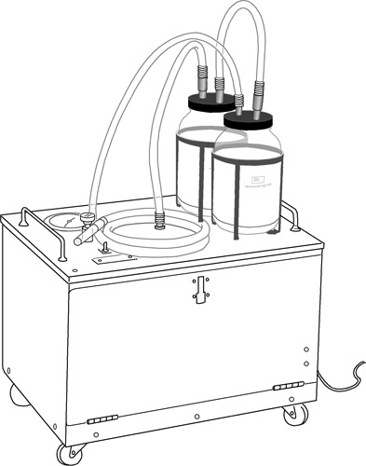
EVA machine
Notes:
Ask: What is EVA?
EVA is similar to MVA except that the vacuum is created by electricity.

Slide 26
Clinical applications for MVA
Treatment of incomplete or missed abortion
Endometrial biopsy
Induced abortion
Notes:
Explain: In every country in the world, there are at least two clinical applications for MVA: treatment of incomplete or missed abortion (also called miscarriage management or management of early pregnancy failure) and endometrial biopsy. Induced abortion (called menstrual regulation in some settings) is also an application for MVA where permitted by law and regulation.

Slide 27
Vacuum aspiration (MVA or EVA)
Vacuum aspiration is extremely safe
It is associated with few complications, especially when performed before 13 weeks gestation
Most studies show success in 98 to 100 percent of cases, including for incomplete abortion
It is less costly when performed on outpatient basis under local anesthesia

Slide 28
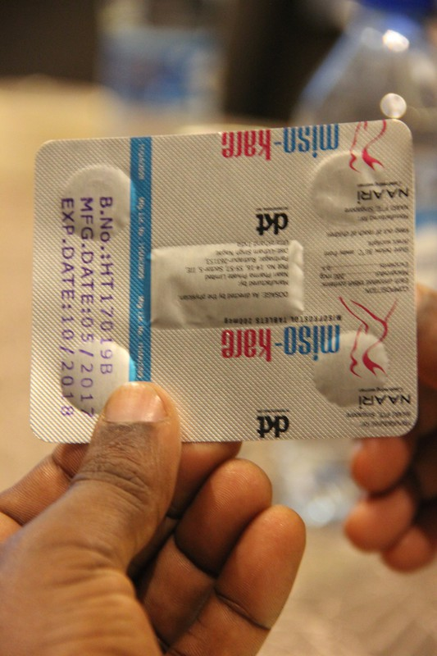
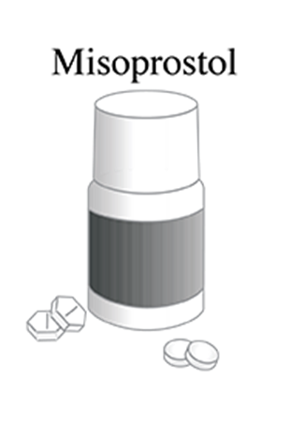
Medical methods
Procure, store and distribute misoprostol in double-foil packaging to prevent degradation
Notes:
Explain: Mifepristone is an oral medication that blocks the action of the hormone progesterone. This leads to detachment of a pregnancy from the uterus. It also softens the cervix and makes the uterus more sensitive to the effects of misoprostol. Misoprostol is a synthetic prostaglandin that softens the cervix and stimulates uterine contractions. Mifepristone plus misoprostol, or misoprostol used alone, cause uterine evacuation through expulsion of uterine contents.
Note that both medications are stable at room temperature and do not require refrigeration. However, misoprostol will degrade in high heat and humidity and should only be procured, stored and distributed in double-foil packaging (as seen in the picture on the slide).

Slide 29
Expectant management for incomplete abortion
Expectant management refers to the process of allowing the uterus to evacuate the products of conception spontaneously over time without provider intervention
Access to emergency care, if necessary
Time to expulsion unpredictable
Effectiveness rate: 52-85%

Slide 30
SAFETY, EFFECTIVENESS, AND ACCEPTABILITY OF VACUUM ASPIRATION

Slide 31
Acceptability of vacuum aspiration for women
Women can remain awake during the procedure
It can be performed as outpatient procedure
Women do not have to stay overnight
MVA is quiet
Notes:
Ask: What are the advantages of vacuum aspiration over sharp curettage?

Slide 32
Advantages of vacuum aspiration over sharp curettage
Lower risk of complications
Less cervical dilatation is required
Can be performed as an outpatient procedure
Decreased need for anesthetic drugs

Slide 33
Value of MVA in crisis settings
Appropriate for use in primary care facilities
Appropriate technology for low-resource/crisis settings
Easy to use, clean, and process; requires no electricity
Can be performed by mid-level providers with no difference in complication rates compared to doctors
Notes:
Barnard, S., Kim, C., Park, M., & Ngo, T. D. (2015). Doctors or mid-level providers for abortion? Cochrane Database of Systematic Reviews, 7, CD011242.
World Health Organization. (2015). Health worker roles in providing safe abortion care and post-abortion contraception. Geneva: World Health Organization Press.

Slide 34
POSSIBLE COMPLICATIONS OF MVA
Notes:
Explain: MVA has been shown to have a very low risk of infection or injury. However, as with any medical procedure, there are warnings and precautions.
Read the following paragraphs aloud:
As with any uterine evacuation, one or more of the following may occur during or after the procedure: vagal reaction, incomplete evacuation, uterine or cervical injury or perforation, pelvic infection, hemorrhage or acute hematometra. Serious complications, such as bleeding, necessitating transfusion, or a uterine injury requiring surgical repair, are very rare and occur much less than 1% of the time. However, when they do occur, some complications can lead to secondary infertility, serious injury, or death.
Before performing uterine evacuation, any life-threatening conditions should be addressed immediately. These include: shock, hemorrhage, severe pelvic infection, sepsis, perforation, or abdominal injury, as may occur with incomplete or clandestine abortion.
However, uterine evacuation is often an important component of definitive management in these cases. Once the patient is stabilized, the procedure should not be delayed. A history of blood dyscrasia may be a factor in the woman’s care. Uterine evacuation should not be performed until the size and position of the uterus and cervix have been determined. Large fibroids or uterine anomalies may make it difficult to determine the size of the uterus and to perform intrauterine procedures, including MVA.

Slide 35
MEDICAL METHODS FOR UTERINE EVACUATION
Notes:
Post a blank sheet of flip chart paper.
Say/ask: In some cases, women may prefer medical methods for uterine evacuation if the option is available. Why do you think some women may prefer medical methods to vacuum aspiration?
Record responses on the flip chart paper.

Slide 36
Acceptability of medical methods for women
Mifepristone and misoprostol can often be taken at home or another preferred location, and the abortion process completed there.
Some women perceive it as more private and natural than other methods.
Some women prefer a non-surgical option for uterine evacuation.
Studies indicate women’s and providers’ high satisfaction with medical methods in a variety of settings, including where resources are limited.
Notes:
Explain: Misoprostol can be used to treat uncomplicated incomplete abortion for a uterine size of less than 13 weeks. Medical abortion—which includes a combination of mifepristone and misoprostol, or misoprostol only where mifepristone is unavailable—can be used up to 13 weeks LMP. It can also be used after 13 weeks with additional training and with women completing the abortion process in the facility. Emphasize that it is important to always have MVA as a back-up method on site or by referral in case medication methods fail.
For more information about eligibility, routes of administration, regimens, expected effects, side effects, and complications for medical methods for uterine evacuation, see the companion IAWG training module on Uterine Evacuation in Crisis Settings Using Medications, or www.ipas.org. Explain that this training will only focus on MVA.

Slide 37
UTERINE EVACUATION METHODS OPTIONS COUNSELING
Notes:
Refer participants to the handouts: Uterine Evacuation Treatment Options Chart and Advantages/Disadvantages of Medical Intervention Versus Vacuum Aspiration Chart.
Ask: What are the factors in deciding which method to use?

Slide 38
Factors in choosing a uterine evacuation method
Staff skills
Equipment, supplies, and medications available
The woman’s clinical condition
The woman’s personal preference
Choice of contraceptive method
Notes:
Explain: The uterine evacuation method that a woman uses is determined by availability of vacuum aspiration or medical methods, the woman’s medical eligibility for the methods based on her clinical condition, and her preferences, including her choice of contraceptive method.

Slide 39
Discussing contraception and uterine evacuation together
Many women seeking uterine evacuation are motivated to prevent or delay a next pregnancy.
Discuss contraceptive and uterine evacuation options at the same time.
Most methods can be used immediately.
The uterine evacuation method has implications for whether and how certain contraceptive methods can be provided.
Notes:
Say: All women receiving abortion-related care, regardless of their age, marital status or number of children, should be offered contraceptive services. Offering on-site contraceptive counseling and method provision in the unit where abortion-related care is provided as an integrated part of abortion-related services is efficient, effective, and can improve contraceptive acceptance. Most methods can be initiated at the same time as uterine evacuation; providing these services together facilitates women’s ability to protect themselves from unplanned pregnancies. Additionally, in some cases, the method of evacuation chosen can have implications for when a contraceptive method can be initiated. For example, for women who want an intrauterine device (IUD), a vacuum aspiration procedure would allow her to have the IUD inserted immediately without having an additional visit or having to undergo an additional procedure. However, women who choose uterine evacuation with medications would have to return to a provider to have the IUD inserted at a future visit. This may be an important factor in some women’s decision regarding uterine evacuation method.

Slide 40
UTERINE EVACUATION METHOD OPTIONS COUNSELING: CASE STUDIES

Slide 41
INFORMED CONSENT

Slide 42
Obtain informed consent
Notes:
Ask: What do you think voluntary, informed consent means?
Responses should include:
Full information on options.
Benefits, risks, and alternatives to the procedures discussed.
Free decision making without pressure or coercion.
Explain: Voluntary, informed consent should be confirmed before beginning care or administering any medications. Each woman should be given as much time as needed to make her decisions.
Ask: What circumstances might limit a woman’s ability to give true voluntary, informed consent?
Responses should include:
She is under pressure from her partner or family members.
She has difficulty communicating due to language or disability.
She has experienced a traumatic event.
She is in need of emergency care.

Slide 43
Procedure choice
What are the differences between methods
What will be done during and after the procedure
What is she likely to experience
How long it will take
Which pain management options she can choose
What are the expected effects, side effects, risks, and potential complications
Explain aftercare and follow up, if needed
Notes:
Explain: Pain medication should not be delayed once consent has been obtained. Emphasize that treatment is never contingent on a woman’s acceptance of contraception.

Slide 44
UNIT 4: MVA REFRESHER

Slide 45
Unit 4 objectives
By the end of this unit, participants will be able to:
Describe the facts and features of the Ipas MVA Plus and Ipas EasyGrip cannulae
Describe processing MVA instruments in accordance with local regulations and with locally availably products/systems
Describe the steps of providing uterine evacuation with Ipas MVA Plus
Resolve common technical problems
Be competent simulating a uterine evacuation procedure using Ipas MVA Plus on a pelvic model

Slide 46
FACTS AND FEATURES OF IPAS MVA AND IPAS EASYGRIP CANNULAE
Notes:
Distribute an aspirator set to each participant. If you are providing sets to each site rather than each participant, have participants share the sets. Allow them a few minutes to inspect and handle the aspirator and cannulae. Tell participants to follow along using the aspirator in their sets.
Refer participants to the handout: Tips for Using the lpas MVA Plus.

Slide 47
Ipas MVA Plus® aspirator and Ipas EasyGrip® Cannulae
Woman-centered, appropriate technology
Safe and effective for abortion-related care
Can be used in decentralized health care settings

Slide 48
Parts assembled
Notes:
Point to each part of the aspirator on the slide as you mention it.
Describe each part:
Plunger with handle creates vacuum
Valve buttons control release of the vacuum
60cc cylinder holds the products of conception (POC)
Collar stop with retaining clip prevents the plunger from coming out
Say: The Ipas MVA Plus aspirator provides the same amount of vacuum as an EVA machine.

Slide 49
About the Cannulae
Same dimensions, apertures (openings) as Karman cannulae
Slightly more rigid
Permanently affixed base with wings
Sizes 4, 5, 6, 7, and 8mm have two opposing apertures
Sizes 9, 10, and 12mm have one larger, single-scoop aperture
Dots on each cannula at 1cm intervals indicate location of main aperture
Notes:
Say: Ipas EasyGrip cannulae have permanent bases that act as built-in adapters. The cannulae connect directly to the Ipas MVA Plus aspirator without requiring a separate adapter.

Slide 50
Selection of Cannulae
Depends on uterine size and amount of dilation:
Uterine size 4–6 weeks LMP: suggest 4–7mm
Uterine size 7–9 weeks LMP: suggest 5–10mm
Uterine size 9–12 weeks LMP: suggest 8–12mm
Notes:
Say: It is important to use a cannula appropriate to the size of the uterus and amount of cervical dilation present. Using a cannula that is too small may result in retained tissue or loss of suction.

Slide 51
Disassembling the aspirator
Remove cannula by twisting its base and pulling it out of the valve
Pull cylinder and remove it from the valve
Press cap-release tabs to remove the cap
Open hinged valve by pulling open the clasp
Remove valve liner
Disengage collar stop by sliding under retaining clip, or remove completely
Pull plunger completely out of the cylinder
Displace O-ring by squeezing its sides and roll down into groove below
Notes:
Demonstrate using your fully assembled aspirator with cannula attached. Instruct participants to follow along with the aspirator in their sets. Ask a volunteer to disassemble the aspirator. Point to the steps on the slide as you describe how to disassemble the instrument while the volunteer follows your directions.

Slide 52
Remove O-ring
Notes:
Explain: Never use a sharp object to remove the O-ring, as that could damage the ring.

Slide 53
MVA parts disassembled
Notes:
Start with the now fully disassembled aspirator. Ask for another participant to demonstrate the steps of instrument assembly using the disassembled instrument. Ask the participant to follow the steps described on the next slides.

Slide 54
Assembling the Ipas MVA Plus®
Place valve liner in valve by aligning ridges
Close valve; ensure it snaps into place
Snap cap onto the end of valve
Push cylinder into the base of valve
Place O-ring into groove near tip of plunger

Slide 55
Assembling the Ipas MVA Plus® (cont.)
Spread one drop of lubricant around the O-ring with a finger
Squeeze plunger arms, push fully into cylinder
Move plunger in and out to lubricate
Insert collar stop tabs into holes in the cylinder

Slide 56
When assembling the aspirator
Introduce plunger straight into the cylinder
Do not introduce the plunger at an angle

Slide 57
Steps to lubrication
Notes:
Say: It is important to use only one drop of lubricant because over-lubricating can interfere with vacuum capability. Silicone lubricant (which is not sterile) is provided, but other non-petroleum-based lubricant can be used. For example, vegetable or olive oil can be used. We will learn how to prepare the aspirator for use by creating a vacuum with it. This is also called “charging” or “preparing” the aspirator.
Tell participants to follow along with the aspirator in their sets. Point to the parts on the slide as you describe how to prepare the instrument.

Slide 58
Creating a vacuum
Begin with valve buttons open, plunger all the way in and collar stop locked in place
Close valve by pushing buttons down and forward until they lock
Pull plunger back until plunger arms catch on wide sides of the cylinder
Both arms must be extended and secured over the edge of the cylinder
Incorrect positioning of plunger arms can allow the plunger to slip back into the cylinder
Notes:
Say: Never grasp the charged aspirator by the plunger arms because it could lose vacuum or eject its contents.

Slide 59
Check aspirator for vacuum
Charge aspirator
Leave charged for several minutes
Push buttons to release vacuum
A rush of air indicates vacuum was retained

Slide 60
Checking why vacuum fails
Check that it is properly assembled
Inspect O-ring for proper positioning and lubrication
If the O-ring is damaged, replace it
Ensure that no foreign bodies are present
Check cylinder is firmly seated on valve
Charge and test again
Notes:
Say: Look at your aspirator sets. Show participants the Ipas MVA Plus product insert that comes with every aspirator and includes information about the instrument.
Demonstrate instrument assembly and preparation again, this time asking participants to follow along with their instruments. Ensure that all participants have properly assembled and prepared their aspirators. Determine if anyone is having any difficulty with assembly, especially with inserting the plunger O-ring.
Show the participants in detail the correct position of the plunger arms over the edge of the cylinder. Ensure that all participants have now properly charged their aspirators. If necessary, coach individual participants. Tell them to leave their instruments charged and not release vacuum until they are instructed.
Demonstrate how to release the valve buttons. Ask one participant at a time to release the vacuum in their aspirators. Ensure that all participants have properly tested their aspirators. If they did not hear the rush of air indicating vacuum release, check to determine why they failed to create a vacuum.
Describe what you are doing to each part as you disassemble your aspirator, following the steps outlined previously. Ask participants to disassemble their devices while you walk around the room coaching them. Ensure that all participants have properly disassembled their aspirators. Finally, have them practice assembling, charging, and disassembling their instruments while you walk around coaching them.

Slide 61
MAINTAINING IPAS INSTRUMENTS

Slide 62
Ipas MVA Plus® Aspirator care and processing
Must be soaked, cleaned, and high level disinfected (HLD) or sterilized between patients
Does not have to be HLD or sterile at time of use (like a speculum)
Should be rinsed or soaked in water promptly after use to ease removal of tissue
Notes:
Say: The MVA aspirator does not directly touch the woman’s body. However, when it is used, the cylinder fills with blood. There is the potential risk that some contaminants from a previous woman could be introduced to another woman if the MVA aspirator is not fully processed (soaked, cleaned and sterilized or HLD) between each use. Therefore, after cleaning, the Ipas MVA Plus must undergo high-level disinfection or sterilization between patients to remove contaminants. Once processed, the aspirator may be kept in a clean container. We will go into more detail on these points later in this module.

Slide 63
Number of times the instruments can be used
When Ipas instruments are processed using the recommended methods, the number of uses can be expected to be up to 25
Actual number of uses may vary depending on how they are used and maintained

Slide 64
Replace Ipas MVA Plus® Aspirator when:
Cylinder is cracked or brittle
Mineral deposits inhibit plunger movement
Valve is cracked, bent, or broken
Buttons are broken
Plunger arms do not lock
Aspirator no longer holds a vacuum
Notes:
Ask: What steps should you follow if the vacuum fails?
Use an assembled instrument to demonstrate and describe what to do when vacuum fails:
Check that it is properly assembled
Inspect O-ring for proper placement and lubrication
If O-ring is damaged, replace it
Ensure no particles are present
Check valve is firmly seated on cylinder
Charge and test again
If vacuum is still not retained, use another aspirator
Say: Now that we are knowledgeable about maintaining the aspirator, we will discuss maintenance of the cannulae. In the United States and some other countries, Ipas cannulae are labeled for single use only. In settings where instrument reuse is permitted by local regulations, Ipas EasyGrip cannulae are reusable devices.

Slide 65
Ipas EasyGrip® Cannulae care and processing
Manufacturer-sterilized with ethylene oxide
Should be cleaned, sterilized, or HLD before reuse
After use, process promptly to ease cleaning
Notes:
Ask: Why should the cannulae be either sterile or high-level disinfected (HLD) before use?
The cannulae should be sterile or HLD before use because they come in contact with the sterile uterus.

Slide 66
Discard and replace cannula if:
It is brittle
Tissue cannot be removed with cleaning
It is cracked, twisted or bent, especially near aperture
Notes:
Pass around the worn aspirators and cannulae that you brought as samples of devices that should be replaced. Ask learners to explain why each should be replaced.

Slide 67
INSTRUMENT PROCESSING
Notes:
Note to trainer: You may want to create Instrument Processing Practice Stations for participants to work in pairs practicing the method that is used in the crisis setting.
Show the 17-minute Ipas video Processing the Ipas Instruments and quickly review and answer questions with the following content.
Say: We process instruments to protect our clients and ourselves. Proper instrument processing also prevents the spread of infection from the health care facility to the wider community.

Slide 68
Standard precautions when processing
Consider all blood and body fluids to be infectious
Always wear gloves when handling any body fluids, except sweat
Use barriers when a part of the body may be exposed to body fluids: gloves, gown, face protection
Guard against puncture injuries from sharp instruments
Wash hands immediately before and after contact with contaminated items, even if gloves are worn

Slide 69
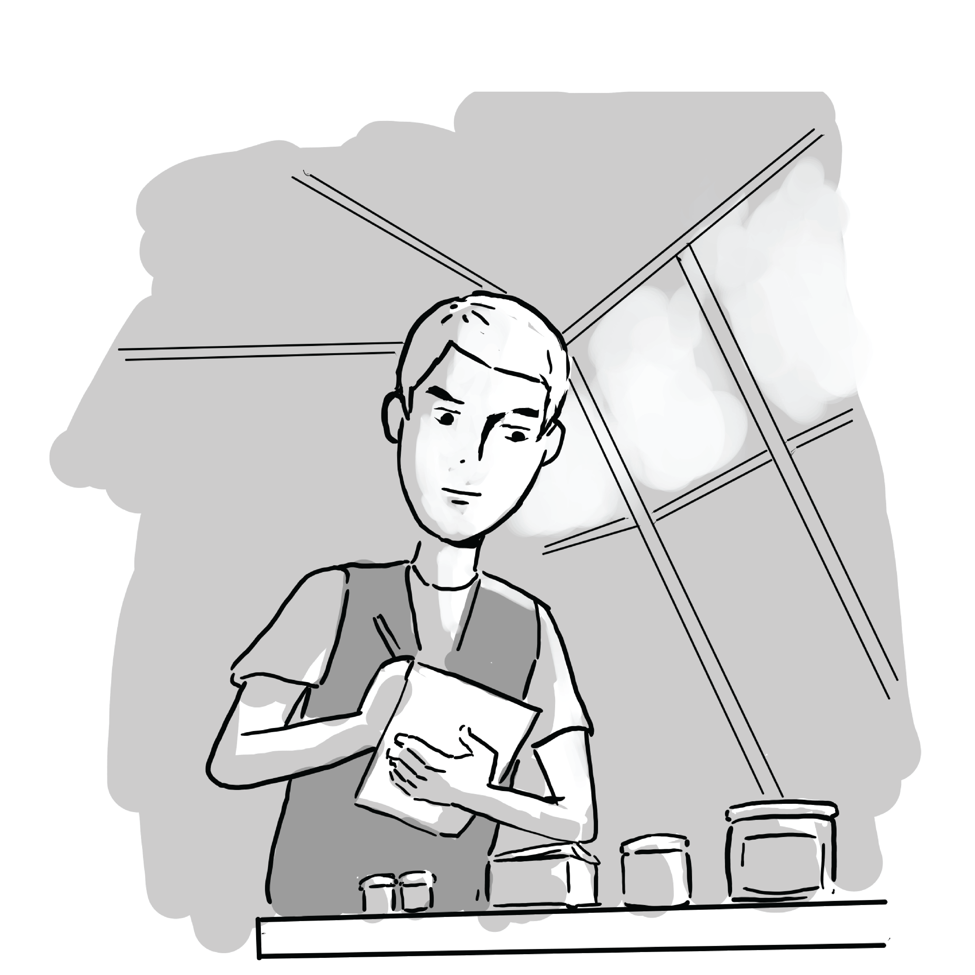
Ipas MVA Plus® Aspirator and Ipas EasyGrip® Cannulae processing
Reusable in settings where instrument reuse is permitted by local regulations

Slide 70
Difference between disinfectants and antiseptics
Disinfectants are strong germicides used to clean equipment
Antiseptics are weak germicides used on people, not instruments
Notes:
Refer participants to the handout: Instrument Processing Skills Checklist. Allow participants a minute to look at it. Then, ask them to follow along as you present the information. Explain that although participants may not process instruments themselves, they should use this checklist to ensure the quality of instrument processing.

Slide 71
Four steps for processing instruments
Point-of-use preparation
Cleaning
Sterilization or high-level disinfection
Storage

Slide 72
STEP 1: POINT-OF-USE PREPARATION

Slide 73
Why soak instruments before cleaning?
Makes cleaning easier by keeping instruments wet
Removes some material
Items are still not safe to handle with bare hands

Slide 74
Steps in point-of-use preparation
Fill a plastic container with water
Do not use chlorine or saline
Wearing gloves, submerge instruments completely
Then draw solution into cannula and aspirator
Soak instruments until ready to clean
Use gloves or forceps to remove
Notes:
Ask: What are some possible mistakes you might make in the soaking process?
Responses should include:
Not wearing gloves
Not fully submerging instruments
Allowing instruments to dry

Slide 75
STEP 2: CLEANING

Slide 76
Cleaning
WHO says cleaning is the most important step to ensure proper final decontamination of instruments
Wash all surfaces in warm water and detergent
Use probe or cloth to remove trapped material
Clean all crevices and inside cylinder, valve, and plunger
Use a soft brush; nothing sharp or pointed
Do not splash
Clean until no blood or tissue is visible, then rinse
Allow items to dry
Notes:
Say: If tissue is trapped in the tip of a cannula, flush water through the cannula repeatedly or use a cotton tipped probe, soft brush, or soft cloth to gently remove material.
Ask: What are some mistakes that commonly occur while cleaning?
Answers should include:
Not wearing barriers
Not fully cleaning the instrument
Using antiseptics instead of detergent
Say: Do not use sharp items to remove the O-ring. Squeeze or use a blunt instrument to gently displace it. Instruments must be completely clean before further processing. Discard the instrument if you are unable to remove blood or tissue during cleaning.

Slide 77
Ipas MVA Plus® Aspirator
Must be high-level disinfected (HLD) or sterilized between patients
This prevents potential blood borne pathogens from being transmitted between patients in case of problems during the procedure where aspirator contents may make contact with a woman’s body
The aspirator does not need to remain HLD or sterilized before the next patient

Slide 78
Ipas EasyGrip® Cannulae
Must be HLD or sterilized between patients
Must be HLD or sterile at time of use

Slide 79
STEP 3: PROCESSING OPTIONS

Slide 80
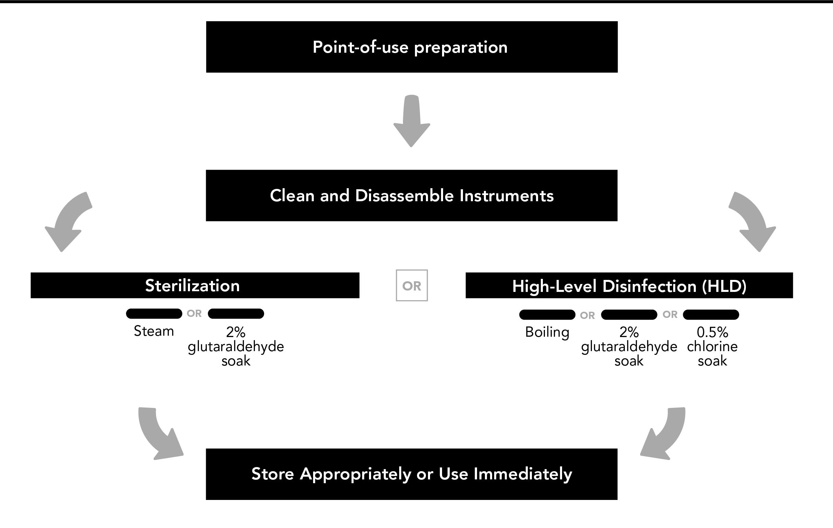
Common options for processing: Ipas MVA Plus® and Ipas EasyGrip® Cannulae
Notes:
Boiling
Glutaraldehyde (Cidex)
Steam autoclave

Slide 81
Option: 0.5% Chlorine (HLD)
Use a plastic (non-metal) container.
Fully immerse and ensure that solution fills instruments.
Soak for 20 minutes.
Remove using HLD or sterile gloves or forceps.
Rinse with boiled or sterile water.
Dry with sterile cloth, if desired.

Slide 82
Option: Boiling (HLD)
Place in water at a rolling boil – items do not need to be fully immersed
Boil for 20 minutes
Remove using HLD or sterile gloves or forceps
Dry with sterile cloth, if desired
Cool before use

Slide 83
Boiling MVA Instruments
Notes:
Ask: What mistakes can be made when boiling the instruments?
Responses should include:
Water not actually boiling
Insufficient length of boiling time

Slide 84
Option: Glutaraldehyde (Sterilization)
Fully immerse and ensure that solution fills instruments
Soak according to manufacturer’s instructions – most recommend 10 hours
Remove with sterile forceps or gloves

Slide 85
Option: Glutaraldehyde (Sterilization) (cont.)
Rinse with sterile water
Dry with sterile towel, if desired
Change solution when it expires

Slide 86
Option: Glutaraldehyde (HLD)
Fully immerse and ensure that solution fills instruments
Soak according to manufacturer’s instructions – recommendations range from 20 to 90 minutes
Remove using HLD or sterile gloves or forceps

Slide 87
Option: Glutaraldehyde (HLD) (cont.)
Rinse with sterile or boiled water
Dry with sterile cloth, if desired
Change solution when it expires

Slide 88
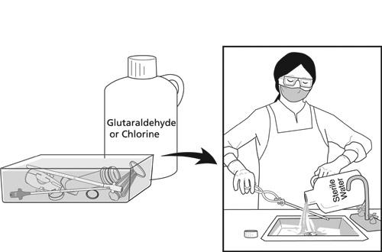
HLD soak and rinse
Notes:
Ask: What mistakes might be made during sterilization or HLD using chemicals?
Responses should include:
Items not submerged or filled
Cannula opening obstructed
Instrument not disassembled
Solution expired or incorrectly mixed
Time is not correct
Instruments not rinsed

Slide 89
Option: Steam autoclave (sterilization)
Wrap clean, disassembled items in paper or linen
Arrange items so steam penetrates all surfaces
Instrument openings not obstructed; parts do not touch
Cool before use

Slide 90
Paper wrap
It is very important to autoclave the instruments properly or damage could occur.
Notes:
Say: It is very important to autoclave the instruments properly to avoid damaging them.

Slide 91
Steam autoclave: Caution
Process at 121°C (250°F) with 106 kPa (15lbs/in2) pressure for 30 minutes
Be sure the autoclave is set to these parameters
Do not use other autoclave settings or “flash” the instruments
Higher temperature settings can damage instruments
Notes:
Ask: What mistakes can be made when steam autoclaving MVA instruments?
Responses should include:
Temperature, pressure, or time is not correct
Autoclave is set on higher settings
Items are not wrapped or arranged properly for steam contact
Cannula opening obstructed
Instrument is not properly disassembled

Slide 92
STEP 4: STORE OR USE IMMEDIATELY

Slide 93
How to store MVA instruments
Ideally, reprocess cannulae every day if boiled or soaked
Storing items that are even slightly wet invites microbial growth
Keep just a few cannulae in each container
Avoid touching cannulae tips; grasp cannulae by the base
Store instruments in an environment that preserves the level of processing desired
Notes:
Say: After the instrument has been processed, it has to be reassembled (including lubrication). Test the vacuum before use or storage.

Slide 94
UTERINE EVACUATION WITH THE IPAS MVA PLUS®
Notes:
Show the instructional video Manual Vacuum Aspiration Technique Using the Ipas MVA Plus Aspirator and Ipas EasyGrip Cannulae (8 minutes) and then discuss each step of the procedure.

Slide 95
Steps of the MVA procedure
Prepare instruments
Assist the woman
Perform cervical antiseptic prep
Perform paracervical block
Dilate cervix
Notes:
Say: These are the general steps for the MVA procedure. The exact sequence will vary slightly based on local circumstances.

Slide 96
Steps of the MVA procedure (cont.)
Insert cannula
Suction uterine contents
Inspect tissue
Perform any concurrent procedures
Take immediate post-procedure steps, including instrument processing
Notes:
.

Slide 97
Step 1: Prepare instruments
Check that the aspirator retains a vacuum
Have more than one aspirator available
Notes:
Say: You will want to have more than one aspirator available in case of technical problems or copious products of conception. Ensure that all necessary equipment and supplies are available.

Slide 98
Create a vacuum

Slide 99
Step 2: Prepare the woman
Ensure pain medication is given at the appropriate time
Administer antibiotics
Ask the woman to empty her bladder
Help her onto the table
Ask for her permission to start
Wash hands and put on appropriate barriers
Perform a bimanual exam
Select and insert speculum

Slide 100
Pre-procedure provision of antibiotics
Administer prophylactic antibiotics to all women
Prophylactic: reduces risk of infection
Administer therapeutic antibiotics to women with signs and symptoms of infection
Monitor for allergic reaction
Notes:
Say: Research has shown that routinely providing antibiotics to women undergoing MVA reduces infection.

Slide 101
Wear barriers for MVA procedures

Slide 102
Perform bimanual exam
Notes:
Say: The woman should empty her bladder before she gets on the table because a full bladder makes the pelvic exam difficult to perform.
Ask: Why conduct a bimanual exam now?
To confirm previous findings regarding the size and position of the uterus.
Say/Ask: It may be helpful to take a few minutes to reassure the woman before the procedure. Why might this be important in crisis settings?
In many cases women have been subjected to harsh living conditions, and emotional and possibly physical trauma.
Ask: What are some ways you can provide comfort to a woman throughout the procedure?
Every woman is different. Before beginning it may be helpful to brainstorm with the woman about ways that might help bring her comfort during the procedure. Some possibilities might include:
Assign a nurse, counselor, or the woman’s loved one to talk with her through the procedure, offering comforting words of reassurance and encouragement.
Assign a nurse, counselor, or the woman’s loved one to help the woman through some guided imagery exercises, picturing a favorite place, home, or just a pretty sunset.
Offer some distraction tactics to take her mind off the procedure. Ask her to think about a happy place, a happier time, work before living in the crisis setting, loved ones, holidays.
Offer comfort through holding her hand, patting her shoulder.
Play music that she enjoys.

Slide 103
Step 3: Perform cervical antiseptic prep
Follow No-Touch Technique
Use antiseptic sponges to clean cervical os, cervix and, if desired, vaginal walls
Do not retrace areas previously cleaned

Slide 104
Antiseptic cervical preparation
Notes:
Ask: What is the No-Touch Technique?
Handling instruments so that the part that will enter the sterile uterus does not touch any other surface, including gloved fingertips or vaginal walls.
Emphasize that the No-Touch Technique is important because infection can start when vaginal or other flora is introduced into the uterus during the procedure. The No-Touch Technique must be used throughout the procedure.
Ask: Why is the cervical antiseptic prep important?
During the procedure, microorganisms in and around the vagina are very often transferred through the os into the uterus, or by the block needle to deep cervical tissue, where they can cause infection.
Ask: Why not retrace with the sponges?
Retracing with the sponge can cause contamination by carrying microorganisms from unswabbed areas onto already-cleaned areas.

Slide 105
Step 4: Perform paracervical block
Recommended for all MVA procedures
Usually 20 mL of 1.0 percent lidocaine (always less than 200 mg)
Always aspirate (pull back on the plunger) slightly before injecting to prevent intravascular injection
If 1% lidocaine is unavailable, 10 mL of 2% may be substituted
A two-point paracervical block technique (injecting at 4 and 8 o’clock)
Notes:
Say: Most women experience pain when the cannula is inserted through the os, as well as when the os contracts after the evacuation. Since paracervical block aids in preventing pain and is unlikely to cause harm, it is recommended that it be administered to all women needing uterine evacuation.
Paracervical block is safe and easy to do and may be done by midlevel providers. It is important to aspirate before injecting to be sure the needle is not in a vessel, which can cause very serious problems.

Slide 106
Administering paracervical block
Start with 20 mL of 1% lidocaine (buffered or unbuffered)
Inject 2 mL of anesthetic where tenaculum will be placed (12 o’clock)
Place tenaculum
Apply slight traction to move cervix, exposing transition from cervical to vaginal tissue
The remaining 18 mL are injected in equal amounts at the cervicovaginal junction at 2, 4, 8, and 10 o’clock. The injection is continuous from superficial to deep to superficial to a depth of 3 cm
Always aspirate (pull back on the plunger) before injecting to prevent injecting into a vein
Wait three minutes before dilating cervix

Slide 107
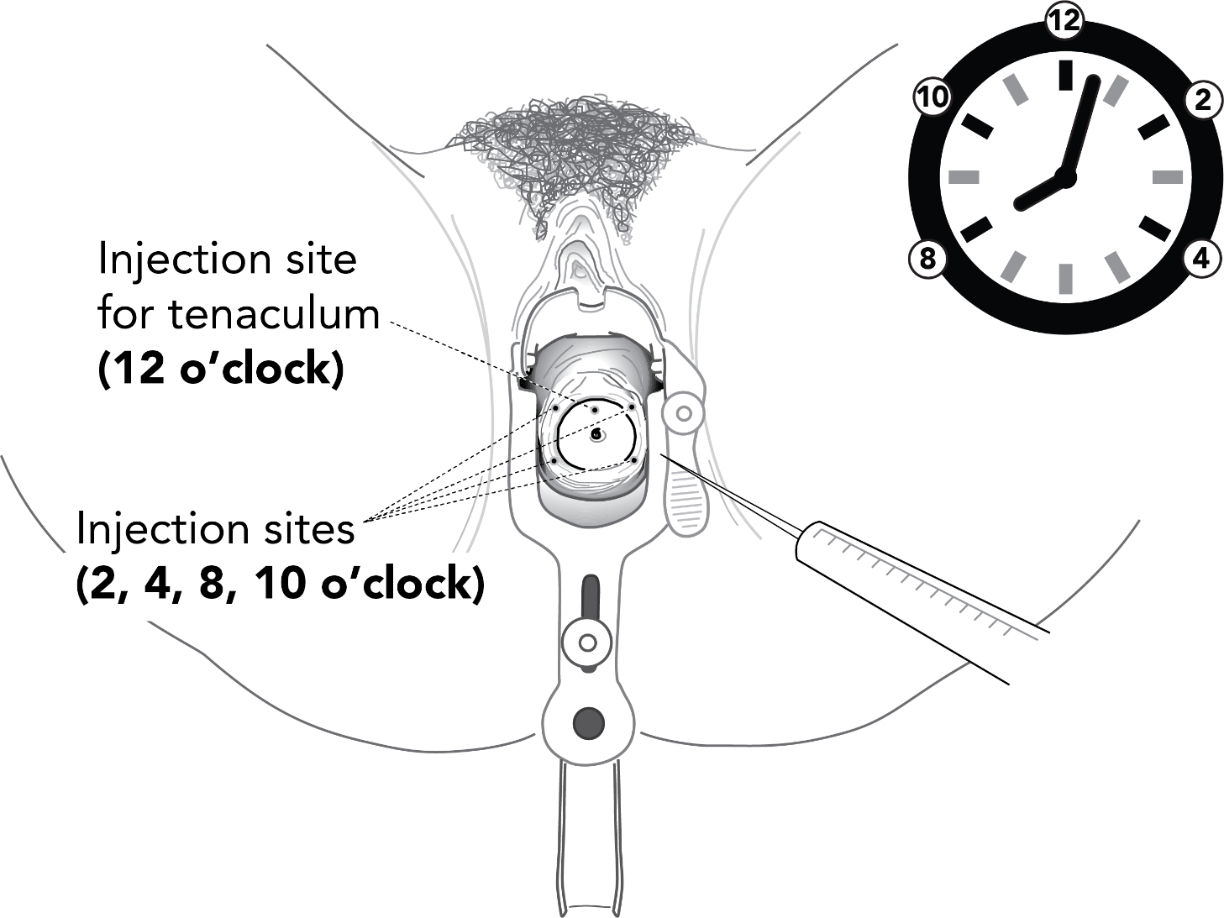
Paracervical block

Slide 108
Step 5: Dilate cervix
Dilatation required in most but not all cases
Women with inevitable or incomplete abortion may require minimal or no dilatation
Cannula should fit snugly in os
Use gentle operative technique
Use progressively larger cannulae or mechanical dilators
After 12 to 14 weeks, cervical preparation with osmotics or misoprostol should be routinely used
Notes:
Say: Using gentle operative technique is important during dilatation to avoid creating a false passage, cervical tear, or perforation, especially as cervical tissue will be softened with pregnancy.

Slide 109
Step 6: Insert cannula
Gently apply traction to the cervix
Rotate the cannula while gently applying pressure
Insert cannula just past internal os
Alternately, insert cannula slowly until it touches the fundus, then draw it back

Slide 110
Insert cannula into the uterus
Notes:
Say: A cervical tear can occur if the cervical traction is too strong. A uterine perforation can occur if the cannula is inserted too far through the os.

Slide 111
Attach aspirator

Slide 112
Step 7: Suction uterine contents
Attach charged aspirator to cannula
Release buttons to start suction
Gently rotate cannula 180 degrees in each direction
Use a gentle “in and out” motion
Do not withdraw cannula opening beyond external os
Notes:
Say: Remain alert to signs that may indicate perforation throughout the procedure and stop suction immediately if they appear.

Slide 113
Release buttons

Slide 114
Evacuate uterine contents
Notes:
Ask: Why should you not withdraw the cannula opening out beyond the external os?
Vacuum will be lost.
Ask: Though it is necessary, what is the risk with using an “in and out” motion?
There is a risk of uterine perforation.

Slide 115
Signs that the uterus is empty
Red or pink foam without tissue passing through cannula
Gritty sensation over surface of uterus
Uterus contracting around cannula
Increased uterine cramping or pain

Slide 116
When the procedure is finished
Depress buttons down and forward to close valve, then disconnect cannula from aspirator
OR, withdraw cannula and aspirator from the uterus without depressing buttons
Keep instruments ready to evacuate again after inspecting POC, if needed

Slide 117
Use care to disconnect cannula
Ipas EasyGrip cannulae fit firmly into the valve of the aspirator
Use care when disconnecting cannulae from the aspirator

Slide 118
Detach cannula from aspirator

Slide 119
Step 8: Inspect tissue
Empty contents of aspirator into a container
Look for POC; villi and decidua should be visible

Slide 120
Inspect tissue for:
Quantity and presence of POC
Complete evacuation
Molar pregnancy

Slide 121
Detailed tissue inspection
Notes:
Say: If the visual inspection is not conclusive, the material should be strained, immersed in water or vinegar, and viewed with light from beneath. If indicated, a tissue specimen may also be sent to a pathology laboratory.
Ask: What might it mean if the POC inspection shows less tissue than expected or tissue sample is inconclusive?

Slide 122
Possible reasons for no visible POC
A spontaneous abortion has already completed itself
Uterine cavity still contains POC
Ectopic pregnancy
Uterine anatomical variation prevented evacuation

Slide 123
Possible reasons for less than expected POC
Incomplete procedure; re-evacuation necessary
Incorrect estimation of length of pregnancy
Notes:
Say: The MVA procedure is almost done if the exam of POC is satisfactory. In all cases, POC are handled as infectious material. If significant bleeding continues or other issues are identified, the provider should intervene as needed.

Slide 124
Step 9: Perform any concurrent procedures
If POC inspection results are satisfactory:
Wipe the cervix with swab to assess additional bleeding
Perform concurrent procedure
Notes:
Ask: What concurrent procedure might be done?
IUD insertion
Contraceptive implant insertion
Contraceptive injection and sterilization
Repair of cervical tear

Slide 125
Step 10: Immediately post-procedure
Process or discard instruments
Remove barriers and wash hands
Reassure the woman that the procedure is finished
Help her into a comfortable position
Ensure she is escorted to the recovery area
Record information about the procedure
Notes:
Ask: What questions do you have about the steps for performing the uterine evacuation procedure before we proceed to a demonstration?

Slide 126
DEMONSTRATION AND SIMULATED PRACTICE
Notes:
See instructions in Facilitator’s Guide for more information.

Slide 127
SOLVING TECHNICAL PROBLEMS USING MVA
Notes:
See instructions in Facilitator’s Guide for more information.

Slide 128
Reasons for decrease in MVA vacuum
Aspirator is full
Cannula is withdrawn past os
Cannula is clogged
Aspirator is incorrectly assembled
Notes:
Ask: What do you do if the aspirator is full?

Slide 129
When aspirator is full
Close the valve buttons
Detach the cannula and leave in os
Replace aspirator OR
Empty aspirator into a container by pressing buttons and pushing plunger into cylinder
Establish new vacuum, attach aspirator to the cannula, and resume
Notes:
Say/ask: Many clinicians keep a second prepared aspirator on hand during the procedure and switch aspirators if one becomes full. What should be done if the cannula is accidentally withdrawn past the os?

Slide 130
When cannula is withdrawn past os
Remove cannula and aspirator; do not touch vaginal walls
Detach and empty aspirator
Reestablish vacuum
Reinsert cannula if it has not been contaminated
If contaminated, insert another sterile or HLD cannula instead
Reconnect aspirator to cannula, release vacuum, and resume
Notes:
Ask for a volunteer to demonstrate these steps for the entire group.
Ask: What should be done if the cannula becomes clogged?

Slide 131
When cannula is clogged
Ease cannula back toward, but not through, the external os OR
Depress buttons and withdraw aspirator and cannula out of uterus, avoiding contamination
Remove tissue clogging cannula using sterile or HLD forceps
Reinsert cannula using no-touch technique
Reattach aspirator and continue aspiration
Notes:
Say: Never try to unclog the cannula by pushing the plunger back into the cylinder.
Ask for a volunteer to demonstrate these steps for the entire group.
Ask: What should be done if vacuum is lost?

Slide 132
If aspirator does not hold vacuum
Reassemble and test aspirator
Notes:
Ask: What questions do you have about technical problems during the procedure?

Slide 133
UNIT 5: PAIN MANAGEMENT AND SIMULATED PRACTICE

Slide 134
Unit 5 objectives
By the end of this unit, participants will be able to:
Create a pain management plan with the woman that is sensitive to her situation
Be competent simulating a uterine evacuation procedure using Ipas MVA Plus on a pelvic model (continued)

Slide 135
PAIN MANAGEMENT PLAN
Notes:
Say: Managing the woman’s pain and anxiety is a vital component of high-quality, abortion-related care.

Slide 136
Pain management during MVA
Recommended by WHO for all women undergoing uterine evacuation by any method
Should address physical, procedural, and psychosocial factors associated with pain
Minimizes procedural risk
Woman determines with provider, based on individual needs and preferences
Women’s responses to pain vary, but all should be offered pain management
Providers consistently underestimate the amount of pain a woman experiences
Young women may report higher levels of pain than older women
Notes:
Say: All women who present for abortion-related care should be offered pain management and be provided it without delay.
Ask: What factors might be taken into consideration when helping the woman develop a personalized pain management plan?

Slide 137
Physical factors associated with increased pain with vacuum aspiration
Nulliparity
Higher gestational age
Dysmenorrhea
Young age

Slide 138
Procedural factors associated with pain with vacuum aspiration
Cervical dilatation
Uterine manipulation
Clinical technique

Slide 139
Psychosocial factors associated with increased pain with vacuum aspiration
Anxiety
Depression
Notes:
Say: Addressing the woman’s psychosocial state is part of providing high quality woman-centered care. In a crisis setting, the woman may be feeling high levels of anxiety and intense emotions for a range of reasons.
Ask the participants to name few of these reasons. Be sure most on the list below are named.
Displacement from home and personal possessions
Separation from loved ones
Grieving the death of loved ones
Food/safe water insecurity
Fear of violence
Fear of inability to provide for dependents
Lack of privacy
Lack of clean, sanitary bathroom facilities
Lack of adequate or safe housing
Post-traumatic stress symptoms from witnessing or experiencing traumatic events
Lack of sleep
Say: Additionally, the circumstances surrounding how she became pregnant, her decision to terminate a pregnancy, or her inability to carry a pregnancy to term may be compounded by living in a crisis setting. This anxiety can affect how she perceives and copes with pain and discomfort associated with uterine evacuation.

Slide 140
Addressing pain from cervical dilatation
Anesthetic: paracervical block using lidocaine
Non-steroidal analgesics (ibuprofen or naproxen)
Conscious sedation

Slide 141
Addressing pain from uterine manipulation
Gentle operative technique
Non-steroidal analgesics (ibuprofen or naproxen)
Conscious sedation
Notes:
Say: Note that providing conscious sedation increases the expense, complexity, and potential risks of an abortion procedure. Increased need for monitoring requires facility investments in training and equipment to deliver conscious sedation safely.
Ask: What pharmacological interventions might be provided to alleviate anxiety?

Slide 142
Pharmacological means of addressing anxiety
Anxiolytics relieve anxiety for some women
Non-steroidal analgesics relieve pain, which can reduce anxiety
Conscious sedation

Slide 143
Timing of oral medications
Drugs must be most effective at the time of the procedure
Administer drugs 30 to 45 minutes before the procedure

Slide 144
Addressing pain from psychosocial factors
Support measures in addition to pain medications include:
Calm environment
Respectful interaction and communication
Companion during procedure
Verbal and physical support and reassurance
Gentle clinical technique
Non-pharmacological pain relief such as a heating pad or hot water bottle
All of these support measures supplement, but do not replace, medications
Notes:
Say: Providers can arrange for a female staff person to accompany the woman during the procedure if she prefers. The companion can ask if the woman would prefer silence or distraction by talking with her or leading her through a guided visualization. She can offer to provide the woman information at each step. Facility staff can create a calming environment by de-medicalizing the procedure areas as much as possible and providing appropriate music, lighting, and décor. Music is effective for pain management during vacuum aspiration and may be helpful for uterine evacuation with medical methods as well. All these methods of pain management may also address any preexisting pain the woman may have when she comes for abortion-related care.
Refer participants to the handout: Pharmacological Approaches to Pain Management During MVA. Give participants a minute to review the chart.
Say: We will now create a list of locally available drugs and usual practices. Ask participants to name:
anxiolytics that are locally available
the drugs that are locally available for paracervical block
oral non-steroidal anti-inflammatory drugs or narcotic analgesics that are locally available
Write their answers in the spaces on the flipchart. When the list is complete, ask participants to describe nonpharmacological support measures that could be locally provided to address pain. Write their answers in the spaces on the flipchart. This will result in a comprehensive list of locally available drugs and non-pharmacological support measures for MVA pain management to use in the case study activity.

Slide 145
Helping the woman develop a pain management plan
Discuss the type of pain she may experience during uterine evacuation
Discuss options available to reduce pain
Describe available medications, their effects, and potential side effects
Offer support measures that can be used in addition to pain medication
Ask her to state her preferred support measures
Help her decide on a pain management plan
Notes:
Say: When developing a pain management plan, the woman is the decision maker. Providers should not impose their own preferences but offer the available medication and support options and help the woman decide what she prefers. A woman has the right to refuse pain medications once she has been fully informed about her options.

Slide 146
SIMULATED PRACTICE WITH PELVIC MODELS

Slide 147
UNIT 6: AFTER UTERINE EVACUATION

Slide 148
Unit 6 objectives
By the end of this unit, participants will be able to:
Identify and explain how to recognize signs and symptoms of complications
Discuss medical eligibility for select methods of postabortion contraception including emergency contraception
Provide referrals to other reproductive health services

Slide 149
POST-PROCEDURE CARE
Notes:
Say: Once the MVA procedure is finished, the woman will require high-quality post-procedure care.

Slide 150
Post-procedure care
Care provided after uterine evacuation completed
Any physical complications addressed
Woman informed about her condition and self-care
Woman is provided with contraceptive method, if desired
Ends when she is discharged

Slide 151
Elements of post-procedure care
Physical monitoring
Other physical health issues
Pain management
Emotional monitoring and support

Slide 152
Elements of post-procedure care (cont.)
Contraceptive counseling and provision
Scheduling follow-up care if she desires and providing referrals
Providing discharge instructions
Notes:
Refer participants to the Post-Procedure Care Skills Checklist handout. Ask participants to follow along with the checklist as you discuss the elements of post-procedure care.

Slide 153
Physical monitoring
Take her vital signs immediately
Ensure that the woman is resting comfortably
Review chart for condition, history, baseline vital signs
Ensure recovery from procedure and medications
Evaluate bleeding and cramping at least twice

Slide 154
Physical monitoring (cont.)
Detect and manage complications:
Significant physical decline
Dizziness, shortness of breath, fainting
Severe vaginal bleeding
Severe abdominal pain, cramping
Enlarged and tender uterus

Slide 155
Taking vital signs
Notes:
Tell participants that they can evaluate bleeding and cramping from the woman’s description or from observation. Cramping and bleeding should decrease over time; severe cramping and bleeding is not normal.
Ask: Why is it important to evaluate bleeding, cramping, pain, and vital signs at least twice during the post-procedure period?
Say: You need a baseline evaluation and then a second evaluation to determine if there has been any change—for better or worse—in her status. Levels of pain, bleeding, and cramping cannot be measured in exactly the same way for all women. Although there are norms, providers must be alert to differences among women.

Slide 156
Post-procedure pain management
Evaluate pain level, patterns
Offer choices for pain relief:
Analgesics, Non-steroidal anti-inflammatory drugs (NSAIDs)
Administer, monitor pain medications
Offer empathy and non-pharmacologic support in addition to pain medications such as warm compresses
If a woman’s pain increases, she needs attention
Notes:
Say: One way to help women assess the level of the pain they are experiencing is by using a pain scale.
Ask the woman how her pain compares to the most painful situation in her life on a scale of one to 10 (one is least painful and 10 is most painful).
For low-literacy women, you could draw a line with a happy face at one end and a sad face at the other, then ask them to point to where they are along the line.

Slide 157
Other physical and reproductive health issues
Anemia: counsel on diet, supplements
Rh-immunoglobulin: administer according to protocol
Reproductive-tract infections (RTIs), HIV, violence, infertility, cancer screening: counsel, provide care, and/or refer.

Slide 158
Make referrals if necessary
Notes:
Say: So far, we have focused on physical monitoring. The next element of post-procedure care is emotional monitoring and support.

Slide 159
Emotional monitoring and support
Assess and monitor the woman’s emotions
Respond sensitively to her emotional state
Treat a woman gently
Offer counseling or referrals

Slide 160
Post-procedure contraceptive counseling
Ideally, provide before the procedure
If a woman has not decided on contraception, discuss it again after the procedure when she may be better able to focus on her contraceptive needs
Ensure she receives counseling and a contraceptive method of her choice (if desired), which she understands how to use, or referral
Remember that some women may desire another pregnancy
Notes:
Say: We will discuss more about postabortion contraception shortly.

Slide 161
Is follow-up care needed?
Not required after a routine MVA procedure
Make an appointment if the woman desires follow-up
Tailor the appointment to the woman’s condition and needs
Obtain consent to send her records to the follow-up provider
Notes:
Say: When her condition allows, the woman can be discharged.

Slide 162
Woman is ready for discharge
Vital signs are normal
Bleeding and cramping are diminished
She is awake, alert, and able to walk unassisted
She is ready to leave

Slide 163
Normal recovery
A few days of menstrual-like bleeding, cramping
Analgesics, baths, compresses for cramping
Next menses: four to eight weeks
Can get pregnant almost immediately
Intercourse, tampons when any complications resolved

Slide 164
Provide instructions for medications
Notes:
Ask: What other medications might be necessary to administer and explain?
Antibiotics or other drugs, depending on the woman’s condition.
Say: The woman should be informed about what conditions to be alert for and when to seek attention, with 24-hour contact information and emergency phone numbers, if available.

Slide 165
Signs needing immediate attention
Fever, chills, fainting, vomiting
Heavy bleeding
Severe pain

Slide 166
Signs to monitor if they worsen over time
Pain in abdomen or distention of abdomen
Odd or bad-smelling vaginal discharge
Prolonged cramping or bleeding
Delay in resumption of menstruation (more than eight weeks)
Dizziness
Notes:
Say: Discharge instructions may be provided to women in writing as well because they may forget or want to verify their understanding later.
Note to trainer: Not all women will speak the same language as the provider. Therefore, you may need to discuss how providers can tell patients the signs for needing immediate attention with the help of a translator or by using low literacy pictures.
Refer participants to the handout: Discharge Information Sheet.
Note to trainer: As an optional activity, ask participants to practice giving discharge instructions in pairs.

Slide 167
Before discharge
The woman received contraceptive counseling and a method, if desired
A follow-up appointment or any referrals were made, if needed or desired
She was provided a list of counseling and other services available at the facility or in the community
Notes:
Say: There may be other resources in the community to which links can be provided.
Ask participants to brainstorm about services available in their communities to which they could provide referrals. Write all responses on a flipchart and group responses by topic (for example, cancer-screening services) or by location (for example, next town).

Slide 168
Offer contraceptive methods
Notes:
Say: This discharge procedure is routine for women who do not have any complications after abortion-related services. If a woman has suffered any complications:
Give clear, evidence-based explanations of the situation
Include her in decision-making about her treatment
May need additional discharge instructions
Stress the importance of a follow-up visit
Explain that the Post-Procedure Skills Checklist describes all the steps prior to discharge, and that it can be used to develop facility protocols and as a monitoring tool for quality assurance.

Slide 169
FOLLOW-UP CARE
Notes:
Say: Routine follow-up is not necessary. If there are complications, the woman should return to the facility immediately. If the woman desires follow-up care, an optional visit may be scheduled one to two weeks after a uterine evacuation with MVA. Most women do not experience complications from the uterine evacuation procedure. Complications can occur prior to, during, or following the procedure. Those women who do have acute problems should seek immediate care at an appropriate facility.

Slide 170
Follow-up care: Women with complications
Ensure any complications have been resolved
Stabilize, treat, or refer women with acute problems
Explain what the complication was and what it might mean for the woman
Notes:
Say: While follow-up services vary depending on each facility’s resources, there are some basic elements that may be included as part of a follow-up visit.

Slide 171
Follow-up care elements
Confirm success of the uterine evacuation
Ask how she is feeling, including bleeding and any pregnancy symptoms
Conduct a physical examination
If needed, do or refer for ultrasound
Stabilize, treat, or refer for acute problems, ensure that earlier complications are resolved
Perform vacuum aspiration if the uterine evacuation is incomplete

Slide 172
Follow-up care elements (cont.)
Inform the woman of what to expect following completion or continued treatment
Review any laboratory tests results
Provide a contraceptive method, if desired and not already provided
Refer for other medical, gynecologic, or counseling services where indicated

Slide 173
CONTRACEPTIVE COUNSELING AND SERVICES
Notes:
Say: Offering on-site contraceptive counseling and method provision in the unit where abortion-related care is provided as an integrated part of abortion-related services can improve contraceptive acceptance and help break the cycle of multiple unwanted pregnancies.
All women receiving abortion-related care, regardless of their age, marital status, or number of children, should be offered contraceptive services. Refer participants to these handouts in their manual: Postabortion Contraception Medical Eligibility, Contraceptive Counseling Skills Checklist, and Special Contraceptive Counseling Considerations.

Slide 174
Avoid assumptions
Women seek abortion-related care for many different reasons
Providers should not make assumptions about women’s reasons for seeking abortion or postabortion care, whether the pregnancy was wanted, or their desires for future pregnancies
Some women want to be pregnant but are terminating the current pregnancy for medical or other reasons
Women who have had an abortion may want to become pregnant again right away
Notes:
Say: While many women will be highly motivated to begin a contraceptive method at the time of uterine evacuation, and the uterine evacuation visit is an important opportunity to counsel about contraceptives and provide methods, providers should avoid making assumptions about women’s needs or motivations.

Slide 175
Return to fertility
How soon after a uterine evacuation can ovulation take place?
Notes:
Explain: Ovulation can take place within 2 weeks after a vacuum aspiration abortion or incomplete abortion, and as early as 8 days after medical abortion with mifepristone and misoprostol. Contraception should be provided immediately to women who want to prevent pregnancy. A common factor among women receiving abortion- related care is that they are at a critical juncture in their lives and can benefit from compassionate counseling about contraception.

Slide 176
Preferred service delivery model
Counseling and method provision in the unit is ideal
Interim methods when methods of choice are not available
Different cadres of staff can provide contraceptive services

Slide 177
Discussing contraception and procedure together
Discuss contraceptive and uterine evacuation options at the same time
Uterine evacuation method has implications for whether and how certain contraceptive methods can be provided
Discuss the importance of providing information on contraceptive options along with information on the uterine evacuation methods and procedure
Notes:
Say: There are key messages every woman receiving abortion-related care should know before leaving the facility.
Regarding the last bullet, further explain: For example, for women who want an intrauterine device (IUD), a vacuum aspiration procedure would allow her to have the IUD inserted immediately, ensuring that she can leave the facility with her method of choice. However, women who choose medical abortion and desire an IUD must return to a provider to have it inserted. Women who choose an implant can have it inserted immediately, whether they have a vacuum aspiration procedure or medical abortion.

Slide 178
Key messages on postabortion contraception
A woman can become pregnant again very quickly after a uterine evacuation (within 2 weeks, and as early as 8 days after medical abortion with mifepristone and misoprostol)
In general, all methods can be used immediately
Where to go for contraceptive services, including emergency contraception (EC)

Slide 179
Privacy, confidentiality, and informed choice
Privacy and confidentiality are essential in the abortion-related care setting
The woman should be counseled in an area where no one else can see and hear to ensure confidentiality
Providers should follow professional protocols that protect confidentiality
Notes:
Explain: This may be challenging in a crisis setting. Suggest speaking in low tones or going outside to have a conversation. Some women, especially adolescents, may be reluctant to acknowledge that they are sexually active. Living in confined, crowded spaces may make them more reluctant to talk openly about their contraceptive needs.

Slide 180
Informed choice means
Choosing a method voluntarily, without coercion or pressure
Choosing from a wide range of methods
Understanding the benefits and risks of each method
Informed consent is obtained prior to method provision
Informed consent is particularly important for permanent methods such as sterilization
Notes:
Explain: The World Health Organization recommends that sexual and reproductive health services, including contraceptive services, be delivered in a way that ensures fully informed decision-making, respects dignity, autonomy, privacy, and confidentiality, and is sensitive to individuals’ needs and perspectives. Women should be able to choose or refuse contraception based on their personal needs and preferences. Evidence-based, comprehensive contraceptive information, non-directive contraceptive counseling, and support should be accessible for all people, including adolescents, so that they are able to make an informed decision. Ideally, a range of contraceptive methods should be available. Appropriate referrals for methods not available on site should be offered, and these services should be integrated with abortion and postabortion care.

Slide 181
Ask if she would like her partner to be with her
Notes:
Explain: The woman should be asked privately whether she wants her partner included in counseling, both for her medical care and for contraception. If a woman does not want her partner involved, she should be counseled and treated privately, and no information from the visit should be shared with her partner.

Slide 182
Medical eligibility for methods
If there are no severe complications, all modern methods can be used immediately following a uterine evacuation, including by young women
Screen for any medical precautions for particular methods
All methods require adequate counseling and informed consent
Notes:
Say: Long-acting reversible contraceptives (LARC) have many advantages and should be offered as an option for women of all ages.

Slide 183
Long-acting reversible contraceptives (LARC)
LARC includes IUDs and implants
For both young and adult women, LARC are more effective and have higher user satisfaction than short acting methods
LARC are continued longer than pills or injectables
LARC do not require a resupply of contraceptive commodities

Slide 184
Integrating LARC into abortion-related services
Offering LARC enhances women’s access to effective contraception
Women of all ages should be offered LARC as an option
Providers should insert women’s chosen method as soon as possible
Notes:
Remind participants that young women, like older women, can use all contraceptive methods, including LARC. Also note that eligibility for contraceptive methods after postabortion care is the same as after induced abortion.

Slide 185
Uncomplicated vacuum aspiration
All modern contraceptive methods can be used immediately

Slide 186
Vacuum aspiration with complications: Infection
IUD/IUS, sterilization appropriate when infection has been resolved
Avoid intercourse until the infection has been resolved

Slide 187
Vacuum aspiration with complications: Genital injury
Spermicides, female barrier methods may be restricted
Provider must decide whether her condition rules out a particular method

Slide 188
Vacuum aspiration with complications: Excessive blood loss
Delay sterilization if the woman is too anemic

Slide 189
Supply EC pills
Notes:
Ask: Why is it particularly important to offer EC in advance of or in addition to their contraceptive method of choice?
Response should include:
It can be used as a back-up method in case of contraceptive failure, such as when a condom breaks.
It can be used if women forget to use their regular contraceptive method or run out.
It can be used after unprotected sex.
It can be used when sex is non-consensual.
Direct participants to the handout Contraceptive Counseling Skills Checklist.
Explain that this checklist can be used as a reference to guide high-quality contraception counseling, which helps to ensure that women are given the opportunity to make an informed choice of contraceptive.

Slide 190
SPECIAL CONSIDERATIONS: WOMEN IN REFUGEE AND DISPLACED SETTINGS
Notes:
Explain: Refugee and displaced women may be dealing with many different emotional stresses related to safety and personal security issues: institutional, societal, and personal violence; displacement from family, culture, and home; lack of food and other necessities; lack of access to comprehensive medical care; and insecurity about the future.
Many women may have survived violence during the initial period of displacement, while many others continue to experience violence in their present location. It is important when counseling refugee and displaced women to let them guide the counseling process. The provider must be sensitive to language differences between the provider and the woman and have a native speaker of the woman’s language present to translate, if possible.
Ask participants to brainstorm some of the complexities that might be encountered while providing contraceptive counseling to women in crisis settings.

Slide 191
Contraceptive methods: Special considerations
High levels of sexual violence
Possible limited contraceptive method mix
Increased risk of exposure to STIs/HIV
Importance of EC
Vulnerability of women, particularly adolescents
Notes:
Facilitate a discussion about available contraceptive methods, and supply and access issues in the crisis setting. Contraceptive counseling should begin with what will continue to be available and should consider the likelihood of the woman remaining in the setting or moving elsewhere within a given time. Women may have been using one method before displacement and will need to reevaluate what method(s) will work best given their new life circumstances. Consider lack of personal storage and privacy, and discuss the risk of rape and violence, especially for adolescents.
Be sure to discuss the following general points:
High levels of sexual violence, including sexual coercion for food, protection, and shelter; disruption in medical and contraceptive services; and the general uncertainty of refugee life, place refugee women at an increased risk for unprotected sex and unwanted pregnancy.
Medical settings for refugees or displaced persons may not have the full range of contraceptive supplies; providing counseling based on the methods available is most beneficial.
In situations where flight from war, migratory population movement, repatriation, or relocation is imminent, counselors are advised to develop a protocol that addresses the long-term needs of contraceptive clients. The provider and patient can discuss the benefits and drawbacks of each method according to the woman’s individual preferences and situation.
Poverty, high population density, and limited medical provision can all contribute to the increased risk of exposure to sexually transmitted infections (STIs) and HIV. Population migration, increased violence, and military troop movements combine with these factors to create a high risk of exposure to STIs and HIV for refugee and displaced women. Counseling around patients’ needs for barrier methods is important.
Adolescent girls are among the most vulnerable in refugee or displaced settings. Every effort should be made to provide adolescents with contraceptive information and methods.
Counselors should be aware of EC provision in the refugee or displaced setting and counsel women on the availability of EC pills, directions for use, and provision of supplies. A protocol should be developed to provide these pills in advance, where possible.

Slide 192
OTHER SPECIAL CONSIDERATIONS: CASE STUDIES
Notes:
Explain: There are certain specialized considerations providers should keep in mind when providing contraceptive counseling.
Ask participants to review the information provided in their handout Special Contraceptive Counseling Considerations for information on how providers can meet the specific contraceptive needs of women in these circumstances.
Ask a participant to read the following short case studies aloud. Discuss each one at a time.
Note to trainer: The cases cover three of the special populations listed in the handout. You could develop other case studies to substitute or add to those below depending which special considerations are most often seen in the local settings.

Slide 193
Case Study 1: Violence
A 22-year-old married mother of one discloses that she is frequently beaten by her husband. The last beating occurred while she was pregnant. She has come to the facility with a lot of vaginal bleeding and cramping. She is afraid to discuss contraception with her husband.
Notes:
Ask: What are the special contraceptive counseling considerations for this woman?
Responses should include:
If the woman cannot control the circumstances of her sexual activity, advise her about methods that do not require partner participation, such as injectables, implants, IUDs, and EC.
If the violence is a result of her contraceptive use, she may consider a method that cannot be detected by others, such as an IUD, implant, or injectable.
Advise her on how to access and use EC.
It may be beneficial to provide EC pills in advance.
Offer referrals for women experiencing violence.

Slide 194
Case Study 2: HIV
A 28-year-old mother of two comes into the clinic extremely sick and learns that she is HIV-positive. Her only sexual partner has been her husband. She wants to prevent another pregnancy until she receives treatment for HIV and is feeling better.
Notes:
Ask:
What are special contraceptive counseling considerations for this woman?
Responses should include:
Ensure that she has correct information on HIV and how to care for her health and slow the effects of the disease.
Discuss how contraception may interact with medications for HIV and which methods may be better for her.
Oral contraceptive pills can interact with some antiretroviral drugs, resulting in a decrease in the effectiveness of her contraception.
Depot medroxyprogesterone acetate (DMPA) may be used with antiretrovirals without reduced efficacy.
Women who are stable on antiretrovirals may be eligible for an IUD.
Women who are on antiretroviral medications with oral contraception should be encouraged to use condoms to prevent HIV transmission and compensate for any reduced effectiveness of the oral contraception.

Slide 195
Condoms for both females and males
Notes:
Ask: What does dual-method use mean?
Using male or female condoms to prevent STIs/HIV with another contraceptive method to prevent pregnancy, or using condoms to prevent both pregnancy and disease, with EC as a back-up method.

Slide 196
Case Study 3: Young Women
A 16-year-old woman is sexually active with her boyfriend. They use withdrawal because she does not feel comfortable asking him to use condoms. She wants to use something more effective but is afraid her family might be upset if they see her taking birth control pills. She has tried to get injectables in the past, but has been denied by a nurse at the health center because she is not married.
Notes:
Ask: What are special contraceptive-counseling considerations for this woman?
Responses should include:
Learn what her privacy needs are and identify the barriers she may face in using different contraceptive methods, to help her choose the most appropriate option for her.
Some young women may want to become pregnant immediately and do not require contraception. As with all women, ask what her immediate and longer-term reproductive plan is.
Include basic information on her menstrual cycle, fertility, and how pregnancy occurs and is prevented, if needed.
Fully explain how any contraceptive she is interested in works, including efficacy, potential side effects, and long-term clinical implications of any side effects, to allay fears about contraceptives causing illness or future permanent infertility.
Offer to have her leave the facility with at least one dose of EC, in addition to her contraceptive method of choice.
Clinical eligibility guidelines are the same for young women as for adult women.
Young women are more likely to experience regret after sterilization.
Methods that do not require a daily regimen may be more effective for some young women. LARC – such as IUDs and implants – have been found to be more effective and have higher satisfaction for young women than pills in preventing future pregnancies.
An IUD would have particular benefits for her because it would not be obvious to her family.
For all LARC there are no resupply concerns and there is no chance of improper use on her part.

Slide 197
MANAGEMENT OF COMPLICATIONS
Notes:
Say: This module addresses complications that may occur before, during, or after vacuum aspiration. Pain management is an essential part of management of complications.

Slide 198
Abortion is a safe procedure
“When performed by skilled providers using correct medical techniques and drugs, and under hygienic conditions, induced abortion is a very safe medical procedure.”
– WHO, 2012
Notes:
Say: As long as effective methods are used, abortion is usually safe. However, even in the most skilled hands, procedural complications can occur.

Slide 199
Types of complications
Presenting
Procedural
Pregnancy-related

Slide 200
Frequency of adverse events
Adverse events | Frequency
Any adverse event after first-trimester vacuum aspiration abortion | < 1%
Serious adverse event after first-trimester vacuum aspiration abortion | < 0.1%
Notes:
Discuss the chart, noting that complications do occur, but they are rare. These numbers come from a large case series in experienced facilities, so complication rates may be higher in facilities with less experienced providers or lower case volume.
Any adverse event after first-trimester vacuum aspiration is less than one percent (8.46/1000).
Serious adverse events after first-trimester vacuum aspiration are less than 0.1 percent (0.71/1000).

Slide 201
Frequency of death
First-trimester vacuum aspiration abortion – 1/1,000,000 (0.0001%)
Notes:
Discuss, noting that the frequency of death is very low.

Slide 202
Assessment and management of complications
The provider needs to:
Do rapid initial assessment and management of shock if woman is presenting for postabortion care
Continually assess the woman for complications
Manage complications by providing pain management, then treating immediately or stabilizing and referring
Notes:
Say: Several types of complications may infrequently occur with vacuum aspiration. These include: incomplete abortion, infection, continuing pregnancy, hemorrhage, cervical, uterine or abdominal injuries, and ectopic pregnancy. First, we will discuss these procedural and pregnancy-related complications. Then, we will discuss presenting complications.

Slide 203
Signs and symptoms of incomplete abortion: Immediate
Heavy vaginal bleeding
Less tissue than expected
Sometimes severe abdominal pain

Slide 204
Signs and symptoms of incomplete abortion: Delayed
Uterine tenderness
Fever, pain, infection
Elevated white blood cell count

Slide 205
Causes of these signs and symptoms
Retained pregnancy tissue after uterine evacuation
Uterine infection (endometritis), especially likely if reproductive tract infection present

Slide 206
Treatment of incomplete abortion
Usually treat with vacuum aspiration
May use misoprostol or expectant management with close monitoring
If woman has heavy bleeding or signs and symptoms of infection, use immediate vacuum aspiration
Notes:
Note that treatment of incomplete abortion is usually vacuum aspiration, whether the initial uterine evacuation method was by vacuum aspiration or medical methods.

Slide 207
Signs and symptoms of uterine infection
Lower pelvic or abdominal pain
Bleeding
Fever and chills
Uterine or lower abdominal tenderness on exam
Cervical motion tenderness
Notes:
Ask: If a woman has signs of infection, what should the provider do?
Responses should include:
Establish antibiotic coverage
Perform/re-perform vacuum aspiration for retained tissue if indicated
Say: The next complication we will discuss is continuing pregnancy. This is rare after uterine evacuation with vacuum aspiration when performed by a trained provider.

Slide 208
Signs and symptoms of continuing pregnancy
On vacuum aspiration, smaller amount of POC than expected
Persistent pregnancy symptoms
Less vaginal bleeding than expected
Uterine size increasing after uterine evacuation
Notes:
Ask participants to describe the cause of this woman’s signs and symptoms.

Slide 209
Continuing pregnancy
Also known as “failed abortion”
Pregnancy continues due to:
Ineffective uterine evacuation
Failure to evacuate gestational sac
Extrauterine pregnancy
Early gestational age (<6 weeks), operator inexperience and uterine anomalies may make it more difficult to evacuate gestational sac using VA
Notes:
Say: Examining the aspirate immediately after uterine evacuation can decrease the risk of failed vacuum aspiration. Vacuum aspiration is the recommended treatment for continuing pregnancy although a second dose of misoprostol is an option where vacuum aspiration is not available and the woman initially had a medical abortion with mifepristone and misoprostol.

Slide 210
Hemorrhage
Rare after safe abortion
May occur because of incomplete abortion, infection or uterine atony
Notes:
Say: Uterine atony is one cause of hemorrhage.

Slide 211
Signs and symptoms of uterine atony
Copious vaginal bleeding
Large, boggy, softened uterus

Slide 212
Factors contributing to uterine atony
Uterus loses muscle tone, cannot stop bleeding
More common in multiparous and later pregnancies
May be a result of incomplete abortion

Slide 213
Management of hemorrhage
Shock management as indicated
Tetanus toxoid and tetanus antitoxin if there was unsafe abortion and vaccination history unknown
For incomplete abortion: immediate uterine evacuation
For uterine atony: uterine massage, uterotonic medications, tamponade
For cervical or vaginal laceration: hemostasis or repair
For suspected intra-abdominal injury: laparotomy or laparoscopy to diagnose and repair
For women not responding to treatment: hysterectomy may be necessary
Notes:
Say: Management should be done step by step to control bleeding. Providers should move quickly to the next step if bleeding is not controlled. Hysterectomy should be done only as a last resort.

Slide 214
Uterotonics for bleeding or stabilization
After uterine aspiration:
Methylergonovine 0.2 mg intramuscularly or intracervically, not for women with hypertension
Misoprostol 800 mcg sublingually or rectally
Oxytocin 10-40 units in 500-1000 mL IV fluid or 10 units intramuscularly
Notes:
Explain: These therapies may be given for bleeding or to stabilize a patient for transfer after vacuum aspiration or postpartum hemorrhage. Cervical, uterine, or abdominal injuries may occur during vacuum aspiration procedures, although they are rare.

Slide 215
Signs and symptoms of cervical, uterine, or abdominal injury
During procedure:
Excessive vaginal bleeding
Sudden excessive pain
Instrument passes further than expected
Aspirator vacuum decreases
Fat or bowel in aspirate
Notes:
What are the signs and symptoms post-procedure?

Slide 216
Signs and symptoms of cervical, uterine, or abdominal injury (cont.)
Post-procedure:
Persistent abdominal pain
Rapid heart rate
Falling blood pressure
Pelvic tenderness
Fever, elevated white blood cell count
Notes:
What might cause such injuries?

Slide 217
Causes of cervical, uterine and abdominal injury
Minor cervical lacerations from tenaculum or dilator, or anything inserted in the vagina during an unsafe abortion
Uterine perforation caused by:
Excessive force used to dilate (such as with stenotic cervix)
Unusual uterine position (for example, very retroverted)
Actual uterine size different than expected

Slide 218
Management of cervical or vaginal laceration
Ensure adequate pain control and proper positioning and lighting
Apply antiseptic solution to the cervix and vagina
Check for more than one laceration
Stop the bleeding by:
Clamping a ring forceps over the tear
Applying silver nitrate, or
Suturing with continuous absorbable suture
Repair with laparotomy any deep tears or sutured lacerations that continue bleeding
Vaginal packing may be used for emergent treatment of bleeding

Slide 219
Management of uterine perforation
If the following conditions are met:
Perforation occurred during aspiration
Woman is stable
No other signs of intra-abdominal injury, and
Evacuation is complete
Then you may admit her and closely observe for signs and symptoms of intra-abdominal injury or hemorrhage.
Notes:
Say: This is appropriate only if the perforation occurred during the uterine aspiration and the provider feels confident that there were no other injuries.

Slide 220
Management of uterine perforation (cont.)
If woman is unstable or has signs of intra-abdominal injury:
Shock management as indicated
Laparotomy or laparoscopy to diagnose and manage, or
Stabilize and transfer her
If evacuation is not complete:
Complete evacuation with laparotomy or laparoscopy and repair any damage, then inspect abdominal cavity carefully for injuries, OR
If laparotomy/laparoscopy not available, prepare to transfer to higher-level facility
Notes:
Say: If the uterus or cervix is beyond repair or bleeding cannot be controlled, a hysterectomy may be necessary. Hematometra is another complication of vacuum aspiration. It refers to the accumulation of blood clots in the uterine cavity.

Slide 221
Signs and symptoms of hematometra
Enlarged, firm, tender uterus
Pelvic pressure
Intense cramps and pain
Lightheadedness
Mild fever
Scant vaginal bleeding
Notes:
Say: Re-evacuation with vacuum aspiration will usually resolve the condition.

Slide 222
Signs and symptoms of a vasovagal reaction
Fainting, loss of consciousness
Cold or damp skin
Dizziness
Nausea
Moderate drop in blood pressure, pulse
Notes:
Explain: Now we are going to discuss vasovagal reaction. Fainting can occasionally occur during vacuum aspiration. This is a vagal reaction to stimulation during the procedure. Typically, it lasts about 10 seconds and does not require intervention.

Slide 223
Cause of vasovagal reactions
Result of vagal nerve stimulation during vacuum aspiration.
Explain that a vagal reaction is not a true complication, but rather a side effect.
Point out that it can be very distressing when a woman experiences a vagal reaction if the staff are not aware of what is going on.

Slide 224
How is vasovagal reaction treated?
Most symptoms pass quickly as the woman regains consciousness and no further treatment is necessary
Occasionally, smelling salts will be needed to revive the woman
In very rare cases, atropine injection will be necessary if the reaction is prolonged
Notes:
Note to trainer: Many participants may be confused about vagal reaction and may mistake it for a more serious condition. Ensure that participants understand that a vagal reaction is not shock and is usually self-limiting without requiring intervention. Vagal reaction may occur with IV insertion, intramuscular injection, vacuum aspiration, or the sight of blood. It is fainting and is self-limited rather than a seizure that might require intervention.
Ask: How is a vasovagal reaction treated?
Make sure the following points are made:
most symptoms pass quickly as the woman regains consciousness and no further treatment is necessary;
occasionally, smelling salts will be needed to revive the woman;
in very rare cases, atropine injection will be necessary if the reaction is prolonged

Slide 225
Ectopic Pregnancy
Usually detected during clinical assessment
Can go undiagnosed, even after uterine evacuation with medical methods, as POC not examined
Medications used in uterine evacuation with medical methods will not treat an ectopic pregnancy
Life-threatening condition – refer or treat immediately
Notes:
Say: Now we will discuss undiagnosed ectopic pregnancy. Again, this is not a complication of the uterine evacuation, but rather a condition that was in place before it. Women should be screened for ectopic pregnancy before uterine evacuation with medical methods or vacuum aspiration but sometimes it is not detected. How does ectopic pregnancy complicate abortion-related care?

Slide 226
Possible signs and symptoms of ectopic pregnancy
After vacuum aspiration: no villi or decidua are seen when POC are examined
Sudden, intense, and persistent lower abdominal pain or cramping, sometimes with:
Irregular vaginal bleeding or spotting
Palpable adnexal mass
Fainting, shoulder pain, rapid heartbeat, or lightheadedness (from internal bleeding). Internal bleeding is not necessarily accompanied by vaginal bleeding.
Notes:
Say: A ruptured ectopic pregnancy is a gynecologic emergency that can be life threatening and requires immediate surgical intervention. A woman with suspected ectopic pregnancy should be treated or transferred as soon as possible to a facility that can confirm diagnosis and begin treatment. We will now review severe presenting complications that occur before uterine evacuation. When a woman presents for postabortion care, it is essential to assess her health and condition immediately. Pain management is an essential part of management of complications.
Ask: Do the majority of women presenting for postabortion care require emergency treatment? What signs and symptoms are they most likely to have? What treatment is required is this case?
Ensure that participants understand that most women have light to moderate bleeding and no complications, and uterine evacuation may be the only treatment required.
Ask: What are the causes of the complications that women may present with in postabortion care?

Slide 227
Causes of complications in postabortion care
Injury from the abortion procedure
Incomplete uterine evacuation
Infection
Notes:
Ask: How should informed consent be handled if the woman needs emergency care?
Responses should include:
When a woman presents with a life-threatening emergency, complete clinical assessment and voluntary informed consent may be deferred until actions have been taken to save the woman’s life.
Ask: What is the first step in providing care to a woman presenting for postabortion care?
Responses should include:
Perform a rapid initial assessment and obtain voluntary informed consent if possible.
Note that a clinical assessment should be done as the provider begins to treat the complications.
Ask: With which severe complications may women present?

Slide 228
Possible presenting severe complications
Shock
Hemorrhage
Sepsis
Intra-abdominal injury
Notes:
Say: Shock can develop in any patient at any time during postabortion care and requires immediate action.
Ask: What is usually a key part of treatment for women presenting with signs and symptoms of pelvic infection, sepsis, or hemorrhage due to incomplete abortion?
Prompt uterine evacuation, usually with vacuum aspiration.

Slide 229
RAPID INITIAL ASSESSMENT AND MANAGEMENT OF SHOCK
Notes:
Explain: Recognizing shock is the first step in providing care to a woman who has told you or who you believe requires postabortion care. Although most women presenting for postabortion care are ambulatory and do not need emergency treatment, some require emergency care and shock must be addressed immediately. To check for shock, use your ABCs.

Slide 230
The “ABC” Signs
Any member of the facility staff can quickly check:
Airway
Breathing
Circulation
Consciousness
Convulsions
Notes:
Ask participants to identify some signs of shock.
Take a few responses and then show next slide.

Slide 231
Signs of shock
Difficulty breathing
Low blood pressure (SBP < 90 mm HG)
Fast pulse
Pallor or cold extremities
Decreased capillary refill
Dizziness or inability to stand
Impaired consciousness, lethargy, agitation, confusion
Low urine output (< 30 mL per hour)
Notes:
Explain: Shock can develop at any time during postabortion care, especially if underlying injuries were not detected during the initial assessment. Once shock is stabilized, it is necessary to determine the underlying cause. Shock in postabortion care is usually either hemorrhagic or septic.
Ask: How do you stabilize for shock?
Answers should include:
Ensure that the airway is open
Elevate the legs
Give oxygen
Give rapid bolus crystalloid (lactated ringers [LR] or normal saline [NS])
Give second liter if vital signs remain abnormal
Transfuse if vital signs remain unstable
Keep warm
Place urinary catheter
Monitor fluid intake and output, including ongoing blood loss
Get laboratory tests, including blood type and crossmatch, hematocrit and hemoglobin, blood cultures, and chemistry tests, if available
Monitor and record vital signs every 15 minutes
Prepare for an emergency transfer if the woman cannot be treated in the facility
Note to trainer: This is not covered in depth in this material. Participants may be relying on other clinical training for these responses.

Slide 232
Stabilization for shock
Ensure that the airway is open; turn the head to the side to prevent aspiration
Elevate the legs to increase return of blood to the heart
Give oxygen – 5 L / minute by mask or nasal cannula
Give rapid bolus crystalloid (LR or NS) by 1-2 large bore IVs, reassess after 1 liter
Give a second liter if vital signs remain abnormal
Transfuse if vital signs remain unstable after 2 liters of IV fluid

Slide 233
Stabilization for shock (cont.)
Keep the woman warm
Place a urinary catheter
Monitor fluid intake and output, including ongoing blood loss
Get laboratory tests: blood type and cross match, hematocrit and hemoglobin, blood cultures, and chemistry tests, if available
Monitor and record vital signs every 15 minutes
Prepare for an emergency transfer if the woman cannot be treated in the facility

Slide 234
SECONDARY ASSESSMENT FOR UNDERLYING CAUSES OF SHOCK
Notes:
Explain: Once shock is stabilized, identify and treat the underlying cause immediately. In order to determine the underlying cause of shock and identify other complications, the provider must now do a more complete, but urgent clinical assessment.

Slide 235
Assessing underlying cause
Take history
From the woman if she is conscious, otherwise from anyone accompanying her
If possible, determine: gestational age and type of abortion procedure
Perform physical examinations: vital signs, heart, lung, abdominal, pelvic
Abdominal distension, rigidity, guarding, rebound
Sources of bleeding during speculum exam
Size and consistency of uterus, cervical motion tenderness, uterine tenderness during bimanual exam

Slide 236
Physical exam considerations
Pain medication for women who are uncomfortable or may need a procedure
Pelvic exam
Good positioning and lighting to identify and treat bleeding
Any instruments or anesthetics that may be needed are prepared and available
Speculum exam
Repair any lacerations during the exam
Inspect cervical os and remove any visible products of conception with forceps
Notes:
Ask: What are the usual causes of shock in postabortion care patients?
Take two or three answers. Ensure participants know that hemorrhagic and infection/septic shock are the usual causes of shock in postabortion care patients.

Slide 237
Hemorrhagic shock
Hemorrhagic shock is the result of severe blood loss, caused by:
Incomplete abortion
Uterine atony, or
Laceration and/or perforation (intra-abdominal injury)

Slide 238
Septic shock
Septic shock is the result of infection caused by:
Incomplete abortion
Intra-uterine infection, or
Intra-abdominal injury
Notes:
Explain: Infection may occur after a uterine evacuation procedure if the abortion was incomplete, infection prevention was not followed, or the woman had a pelvic infection at the time of uterine evacuation. Intrauterine infection (also called endometritis) can become a more generalized infection (sepsis or septic shock) if it is untreated. A woman with sepsis should be hospitalized. First, let us review the signs and symptoms of a uterine infection.

Slide 239
Signs and symptoms of intrauterine infection (endometritis)
Lower pelvic or abdominal pain
Fever and chills
Uterine or lower abdominal tenderness on bimanual exam
Cervical motion tenderness
Unusual or bad smelling vaginal or cervical discharge

Slide 240
Diagnosis of sepsis
Suspected infection plus:
Hypotension (SBP < 90 mmHg) plus:
One or more of the following:
Pulse > 100 beats per minute
Respiratory rate > 24 breaths per minute
Abnormal temperature (< 36°C or > 38°C)

Slide 241
Management of sepsis
Shock management as indicated
Broad-spectrum IV or IM antibiotics until afebrile for 48 hours
Then oral antibiotics for a total of at least 7 days of treatment
Tetanus toxoid and tetanus antitoxin if there was unsafe abortion and vaccination history unknown
For incomplete abortion: immediate uterine evacuation
For suspected intra-abdominal injury: laparotomy with injury repair
For women not responding to treatment: hysterectomy may be necessary
Notes:
Explain: The recommended broad-spectrum antibiotics are ampicillin 2g IV every 6 hours, plus either gentamicin 5 mg/kg body weight IV every 24 hours or metronidazole 500 mg IV every eight hours.
Refer participants to the handout: Management of Complications (PAC) Skills Checklist. Ask if participants have any questions about management of complications.

Slide 242
UNIT 7: SERVICE DELIVERY

Slide 243
Unit 7 objectives
By the end of this unit, participants will be able to:
Describe monitoring and its importance in improving abortion-related services
Describe the general steps for integration of abortion-related services into existing sexual and reproductive health programs
Understand and contribute towards a work plan to ensure the supply and resupply of instruments, medications, and supplies, the sustainability of uterine evacuation services, and ongoing training/mentoring needs

Slide 244
Elements of a monitoring/sustainability plan for uterine evacuation services in crisis settings
Monitor the quality of uterine evacuation services on site
Ensure the sustainability of uterine evacuation services
Ensure the sustainability of on-site postabortion contraception services
Ensure the supply and resupply of medications, instruments, and related supplies
Meet ongoing training/mentoring needs
Notes:
Note to trainer: It may be helpful to post a piece of flipchart paper with these elements for participants to refer to throughout this unit.
Ask: What do you think of when you hear the term “monitoring?” What words or phrases come to mind? What are some of the elements of “monitoring?”
Take several responses before showing the next slide.

Slide 245
What is monitoring?
Monitoring is:
Examining all aspects of care, including client
satisfaction
Tracking services over time to identify strengths and weaknesses
Using data to provide feedback and making adjustments to improve quality
An ongoing process

Slide 246
Why is monitoring important?
Indicates if services are effective or need improvement
Provides information that impacts service delivery and policies
Improves services for clients and workers
Assesses if changes achieve desired effects
Keeps abortion-related services operating at a high standard
If you don’t monitor it, you can’t improve it!
Notes:
Explain: Monitoring can range from simple and inexpensive to more complex and formalized approaches. A simple approach may be for providers to monitor a few of their own service delivery indicators. More formalized approaches usually involve assessment and monitoring across a wide range of service delivery components. One of the more formal monitoring approaches is COPE® for Comprehensive Abortion Care, which is an ongoing quality improvement process and set of tools used by health care staff to proactively and continuously assess and improve the quality of the comprehensive abortion care they provide. There are many other effective approaches as well.
Inform participants that a copy of COPE® for Comprehensive Abortion Care is available for their review.

Slide 247
Why is monitoring especially important in crisis settings?
High staff turnover can affect the quality of services provided.
Women may not return for health care services if they have a negative experience.
There may not be other health care options available, so ensuring high quality services is critical.

Slide 248
Effective monitoring
Is integrated into routine work
Uses simple indicators
Is participatory and open
Is conducted ethically
Is not punitive
Includes recipients of the services, including young women, in the entire process
Notes:
Say: Monitoring can be used to reward staff and increase morale. Managers can use creative incentives in monitoring to promote changes in behavior. Monitoring should never be coercive.

Slide 249
Monitoring is a continuous process
Assess Program
Implement Modified Plan
Modify Action Plan
Develop Action Plan
Re-assess Program
Implement Action Plan
Notes:
Ask: What information are you currently collecting about your services that could be used for monitoring? Take several responses.
Ask participants for examples of how they currently monitor services in their facility.
Responses may include:
Gathering information from logbooks
Reviewing medical records
Assessing inventory of supplies and equipment
Talking with clients
Explain: Compiling and assessing this information helps to determine where services are effective and where improvements can be made. Emphasize that monitoring is a critical component of high-quality service delivery

Slide 250
Suggested components in a logbook/ register for uterine evacuation clients
Date
Client name or unique identifier
Client age
Age of pregnancy (in weeks)
Diagnosis (e.g., induced abortion, incomplete abortion, complete abortion)
Presenting complications (e.g., moderate/light vaginal bleeding, severe vaginal bleeding, sepsis, shock, injury to organs)
Treatment/procedure (e.g., MVA, mifepristone and misoprostol, misoprostol alone, dilation and curettage, parenteral antibiotics, blood transfusion, pain management)
Post-abortion contraception: Yes/No and method selected (e.g., oral contraceptive pills, injectable, implant, IUD, sterilization)
Referral to a higher-level facility
Notes:
Say: This information should be recorded in a gynecology or comprehensive abortion care register and kept in a confidential and locked location. This information can be coded or masked to protect confidentiality.
Discuss the various bullets and clarify as needed. Note that the “presenting complications” would be most pertinent for postabortion care clients.

Slide 251
Indicators
Are measurements that help quantify activities and results
Can help describe overall quality
Notes:
Say: In planning a monitoring system, it is important to consider specific indicators to measure progress. The indicators chosen should reflect the aspects of services to be monitored. It is important to choose indicators that are under staff control. If not, the process can be demotivating.
Ask participants to give some examples of indicators that might be measured as part of monitoring quality of uterine evacuation services. Refer participants to the handout Examples of Abortion Services Monitoring for ideas.
Some examples:
Number and type of uterine evacuations performed
Number and type of complications
Number of women served by age
% of uterine evacuations performed with WHO approved technology

Slide 252
Worksheet for preliminary preparedness for implementation of safe abortion care
Notes:
Say: In 2015, the IAWG Safe Abortion Care Sub-Working Group assessed member agencies to understand the extent to which these agencies were working to increase access to safe
abortion care in humanitarian settings. The assessment revealed that agencies that were successful at integrating safe abortion care into their programs shared similar traits and had implemented similar activities to achieve their success. These findings were synthesized into a multi-step process that any organization can follow to start or expand their safe abortion care programming.
The worksheet shown on the slide and included in your Participant Manual includes these and several other steps to be addressed in planning for and implementing safe abortion care services.
Ask the participants to review and discuss the worksheet and, if time allows, to complete and share their results.

Slide 253
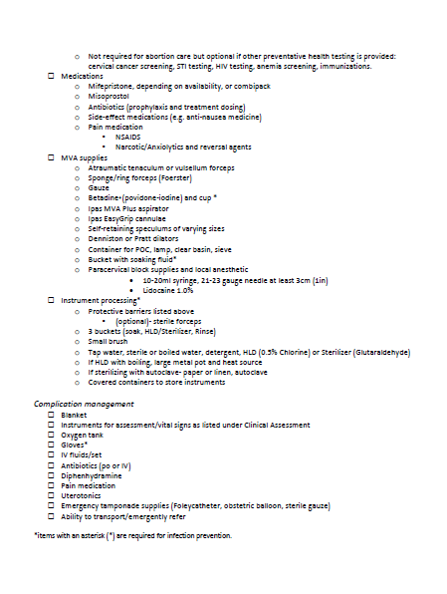
Health facility site set-up
Notes:
Say: This checklist should be used to help plan for service implementation of high-quality comprehensive abortion care – both medical and manual vacuum aspiration – for gestations less than 13 weeks. Many of the items listed are not unique to comprehensive abortion care and may already be available in the facility. Items essential to performing abortion and ensuring safety need to be available prior to service initiation. Other items can continue to be obtained as service provision develops. Items marked with an asterisk (*) are required for infection prevention.
Ask the participants to review the checklist found in their Participant Manuals. If time allows, ask a few participants to share any identified supply gaps.

Slide 254
Ensuring medical abortion & MVA are in full supply
Two actions:
Establishing and maintaining recommended stock levels
active stock to provide services for one month
reserve stock for 3 months
Ensuring facility manager:
understands the importance of keeping medical abortion and MVA in full supply
has the recommended supply guidance tools
Notes:
Say: One of the core issues for starting and sustaining safe abortion care services is ensuring a full and uninterrupted supply of medical abortion medications and MVA equipment.
There are two major points. First, plan for and maintain enough “active stock” to provide services for 1 month and a reserve stock for 3 months. Second, ensure that the facility manager understands the importance of keeping medical abortion and MVA supplies fully stocked and has the recommended supply guidance tools.

Slide 255
Inter-Agency Emergency Reproductive Health (IARH) Kits
MVA and Misoprostol are in Kit 8
Mifepristone and additional misoprostol are available as “complementary commodities”
How to order IARH Kits:
Procurement Services Branch
Marmorvej 51
2100 Copenhagen, Denmark
procurement@unfpa.org
www.unfpaprocurement.org/humanitarian-supplies
https://iawg.net/resources/misp-reference
Notes:
Say: For an acute emergency, the medical abortion medications and Ipas MVA equipment are available in the Inter-Agency Emergency Reproductive Health (IARH) Kits through UNFPA.
MVA and misoprostol are in Kit 8
Mifepristone and additional misoprostol are available as “complementary commodities”
Explain: Complementary commodities are a set of disposable and consumable items and/or kits that can be ordered in specific circumstances to complement existing IARH Kits where:
providers are trained to use the special supply;
the supplies were accepted and used prior to the emergency;
in protracted or post-acute settings (although efforts must be directed to procuring from more stable procurement channels); and
where the use of the supplies is allowed to the fullest extent of the national law.
Refer participants to the MISP for Sexual and Reproductive Health Reference sheet linked on this slide for more information.

Slide 256
Sustainable supply
MVA equipment
Medical Abortion
Ipas MVA equipment is recommended for its quality, durability, and reprocessing options
Place an order with DKT WomanCare by sending an inquiry to: orders@dktwomancare.org
Find a local distributor of Ipas MVA equipment: https://dktwomancare.org/how-to-buy
Use the Medical Abortion Commodities Database (medab.org) to find quality products available in your country
Use your normal medication distributors to request specific brands of medical abortion found in the database
Notes:
Say: As soon as possible, it is important to identify sustainable medical supply channels for uterine evacuation equipment, medications, and supplies.
In 2017, DKT International became the worldwide distributor for Ipas MVA technology. DKT now markets and distributes the Ipas MVA in over 100 countries. The equipment can be ordered directly from DKT or through local DKT distributors.
Ipas MVA Plus® aspirators and Ipas EasyGrip® cannulae have important advantages over other uterine evacuation equipment, including greater durability and more processing options—such as steam autoclave, boiling, and standard high-level chemical disinfectants. Ipas instruments are US FDA-listed, CE-marked, and ISO 13485 compliant.
For medical abortion, it is important to request brands of medical abortion that have been officially registered and gone through a quality assurance process in your country.
IPPF worked closely with Gynuity Health Projects and Concept Foundation to develop the Medical Abortion Commodities Database. The purpose of the database is to improve access to comprehensive country-level information on the availability of different brands of mifepristone, misoprostol, and combipacks that can be used by a range of organizations including governments, private sector pharmaceutical distributors, and nongovernmental organizations.
Note to trainer: If time allows and the internet is available, go to medab.org for a quick tour/demo and search for commodities available in the country in which you are training. Be sure you are familiar with the Medical Abortion Commodities Database before the training.

Slide 257
Ipas supply calculators
Forecasting tools for facility level medical abortion & MVA supply​
Available in multiple formats & languages​
Use historical caseload data to estimate future caseload
Monitor trends​
Manage inventory​ ​
Notes:
Say: Ipas has created some basic and easy to use supply forecasting tools for calculating facility-level medical abortion and MVA supply needs. These are designed for the site-level, but can also be used at a higher-level by aggregating data in different ways.
The calculators are available in online, offline, and mobile versions and in English, French, Portuguese, and Spanish languages.
The user begins by estimating whether the historical caseload will increase, decrease, or remain the same based on the knowledge of their context. This estimated future caseload will be the basis for the forecast and can help forecast initial stock, monitor trends, and manage inventory.
The calculators produce recommendations, but actual use can differ depending on specific situations and factors, such as vendor lead times, storage capacity, finances, etc. The results do not mean you have to go out and buy those amounts. Instead, it is a conversation starter and quantities can and should be adjusted.

Slide 258
Medical abortion calculator
What information will you need?​
Facility caseload data​: all from logbooks
Dosage regimens​: which will provide the average number of pills per client
Procurement information: shipment time, cost of commodity)
What information will you get?​
Average monthly consumption of misoprostol (and mifepristone and mifepristone/misoprostol combination pack, depending on your setting)​
Recommended minimum and maximum inventory levels, with associated costs​
Notes:
Say: In many cases, the data needed for input into the calculators will be already available. In some cases, particularly for the initial use, one may need to track down some information, especially on procurement.
Based on the data you put in, you will get forecasted monthly average consumption for misoprostol, mifepristone, and/or the combi-pack, depending on your setting and what is available.
The calculator will also take this average monthly consumption and provide minimum and maximum inventory levels that should be followed to avoid stockouts.
​

Slide 259
Ipas Supply Calculator
https://www.ipas.org/supply-calculators/ma/
Notes:
Say: Ipas offers two medical abortion calculators. One is for postabortion care-only countries (on the left). The other is for countries with legal indications for induced abortion with medications (on the right).
Note to trainer: If time allows and the internet is available, click on the link to open the medical abortion calculator for a quick tour/demo. Be sure you are familiar with the medical abortion calculator before the training.

Slide 260
MVA calculator
What information will you need?​
# of MVA procedures by facility per month
​# of days per month MVA procedures are available at a facility
When does the facility reorder MVA, e.g., when stocks are low or on a regular basis?
How long does it take to receive an order?
What information will you get?​
Calculates average caseload per day
Calculates maximum # of cases to plan for ensuring coverage 95% of the time
Provides # of active devices needed in procedure room(s)
Provides # of devices needed in reserve stock
Reorder point and reorder quantity
Notes:
Say: Similar to the medical abortion calculator, the data you need for the MVA calculator is likely already available. The MVA calculator uses your estimated caseload. Based on that information, it provides the quantity that a facility should keep in active stock, that is in the procedure room ready to go, and what they should keep in reserve stock as a backup.
​

Slide 261
Ipas MVA Calculator
https://www.ipas.org/supply-calculators/mva/ ​
Notes:
Say: The MVA calculator is simpler than the medical abortion calculator and requires less data to enter. It uses a reuse factor of 25 per aspirator for the calculation.
​​Note to trainer: If time allows and internet is available, click on the link to open the MVA calculator for a quick tour/demo. Be sure you are familiar with the MVA calculator before the training.

Slide 262
MVA Calculator
Notes:
Say: This is a simple chart using the same calculations as the MVA calculator.
To use this, you need to calculate the average MVA caseload per day for your facility with this formula (column A):
estimated # of MVA procedures in 1 month / # of days per month MVA services are offered​
​
Ask participants to calculate their average daily MVA caseload and then use the chart to determine the number of MVA devices needed in active stock and the number needed in reserve.
Take a few ​responses and verify correct use.
​
​

Slide 263
Ipas University (IpasU)
2 pertinent courses:
Managing Facility Supply of Medical Abortion Medicines
Stocking Facilities with MVA
Register for free at:
https://www.ipasu.org/
Notes:
Say: Further learning on managing facility supply of uterine evacuation medications and equipment is available through Ipas University, which is your gateway to learning through Ipas. You will discover a range of free courses on safe abortion care in English and Spanish that you can access, as well as track your own learning to help you develop as a reproductive health professional and learner.
Explain: IpasU is designed for clinicians (in practice and still in training) and other professionals who work in reproductive health programming. IpasU is not meant to be a substitute for clinical training.

Slide 264
UNIT 8: EVALUATION AND CLOSING

Slide 265
Unit 8 objectives
Participants will be able to explain how the training met their expectations and course objectives.

Slide 266
Course objectives (review)
At the end of this training, participants will be able to:
Explain why uterine evacuation is an essential part of reproductive health services in crisis settings
Counsel women seeking abortion in crisis settings
Provide uterine evacuation for women in crisis settings using medications
Recognize and manage women who develop complications from uterine evacuation with medications
Integrate uterine evacuation with medications into their present reproductive health services and organize and monitor the services
Notes:
Review all objectives, reminding participants of activities and methods used to increase knowledge, build skills, and change or strengthen attitudes. Revisit the flip chart paper with participant expectations listed. Ensure that all expectations have been addressed

Slide 267
COURSE EVALUATION
Notes:
Thank participants for their attention and their participation in the short course.
Ask participants to take 10 minutes to complete the Course Evaluation in their manual and provide feedback on which areas of the training went well and which areas could be improved. Remind participants that their input is critical in improving the course.

Slide 268
POST-TEST
Notes:
Ask participants to complete the knowledge Post-test in their manual, which covers content from the entire course.
Ask participants to take 15 minutes to complete the test. Participants should use the same number they selected at the beginning of the training instead of writing their names. The results, along with their participation and skills practice during the Case Study Role-Plays will help assess participants’ readiness to provide uterine evacuation with medications to women.

Slide 269
CLOSING CEREMONY
Notes:
Present each participant with their prepared certificate of completion and congratulate them.

